Slide 1
BRAKING SYSTEM PRINCIPLES
93

Slide 2
Objectives
The student should be able to:
  Prepare for the Brakes (A5) ASE certification test.
  Explain kinetic energy and why it is so important to brake design.
  Discuss mechanical advantage and how it relates to the braking system.
  Explain the coefficient of friction.
  Describe how brakes can fade due to excessive heat.

Slide 3
ENERGY PRINCIPLES

Slide 4
Energy Principles
Energy is ability to do work
  Chemical, mechanical, electrical energy most familiar kinds in operation of vehicle
Work is transfer of energy from one physical system to another
What occurs when vehicle’s brakes are applied
  Force of actuating system transfers energy of vehicle’s motion to brake drums or rotors
  Friction converts it into heat energy and stops vehicle

Slide 5
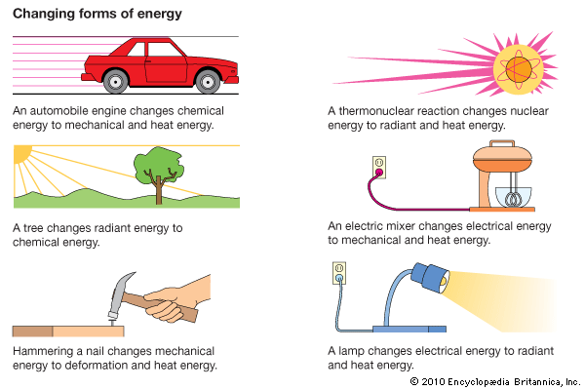
Figure 93-1 Energy which is the ability to perform work exists in many forms.
Notes:
Figure 93-1 Energy which is the ability to perform work exists in many forms.
5

Slide 6
Energy Principles
Kinetic Energy
  Every moving object possesses kinetic energy, and amount determined by object’s mass and speed
  The greater the mass of an object and faster it moves, the more kinetic energy it possesses

Slide 7
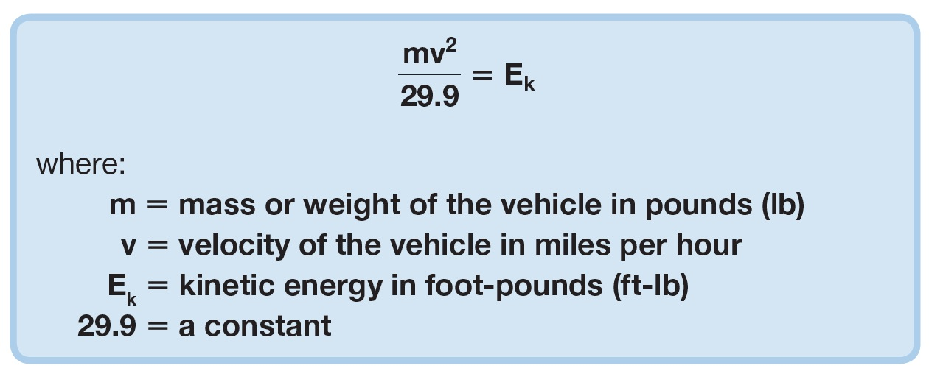
Energy Principles
Kinetic Energy
  Engineers calculate kinetic energy using the following formula:

Slide 8

Energy Principles
Kinetic Energy
  Another way to express this equation is:
  When weight of vehicle is doubled, its kinetic energy also doubled

Slide 9
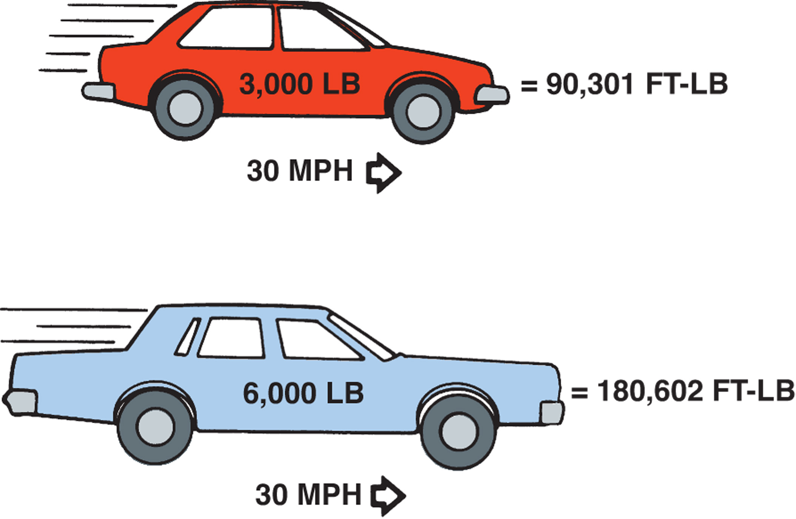
Figure 93-2 Kinetic energy increases in direct proportion to the weight of the vehicle.
Notes:
Figure 93-2 Kinetic energy increases in direct proportion to the weight of the vehicle.
9

Slide 10
Energy Principles
Kinetic Energy
  When speed of vehicle is doubled, its kinetic energy is quadrupled
  If vehicle A weighs twice as much as vehicle B, it needs brake system twice as powerful

Slide 11
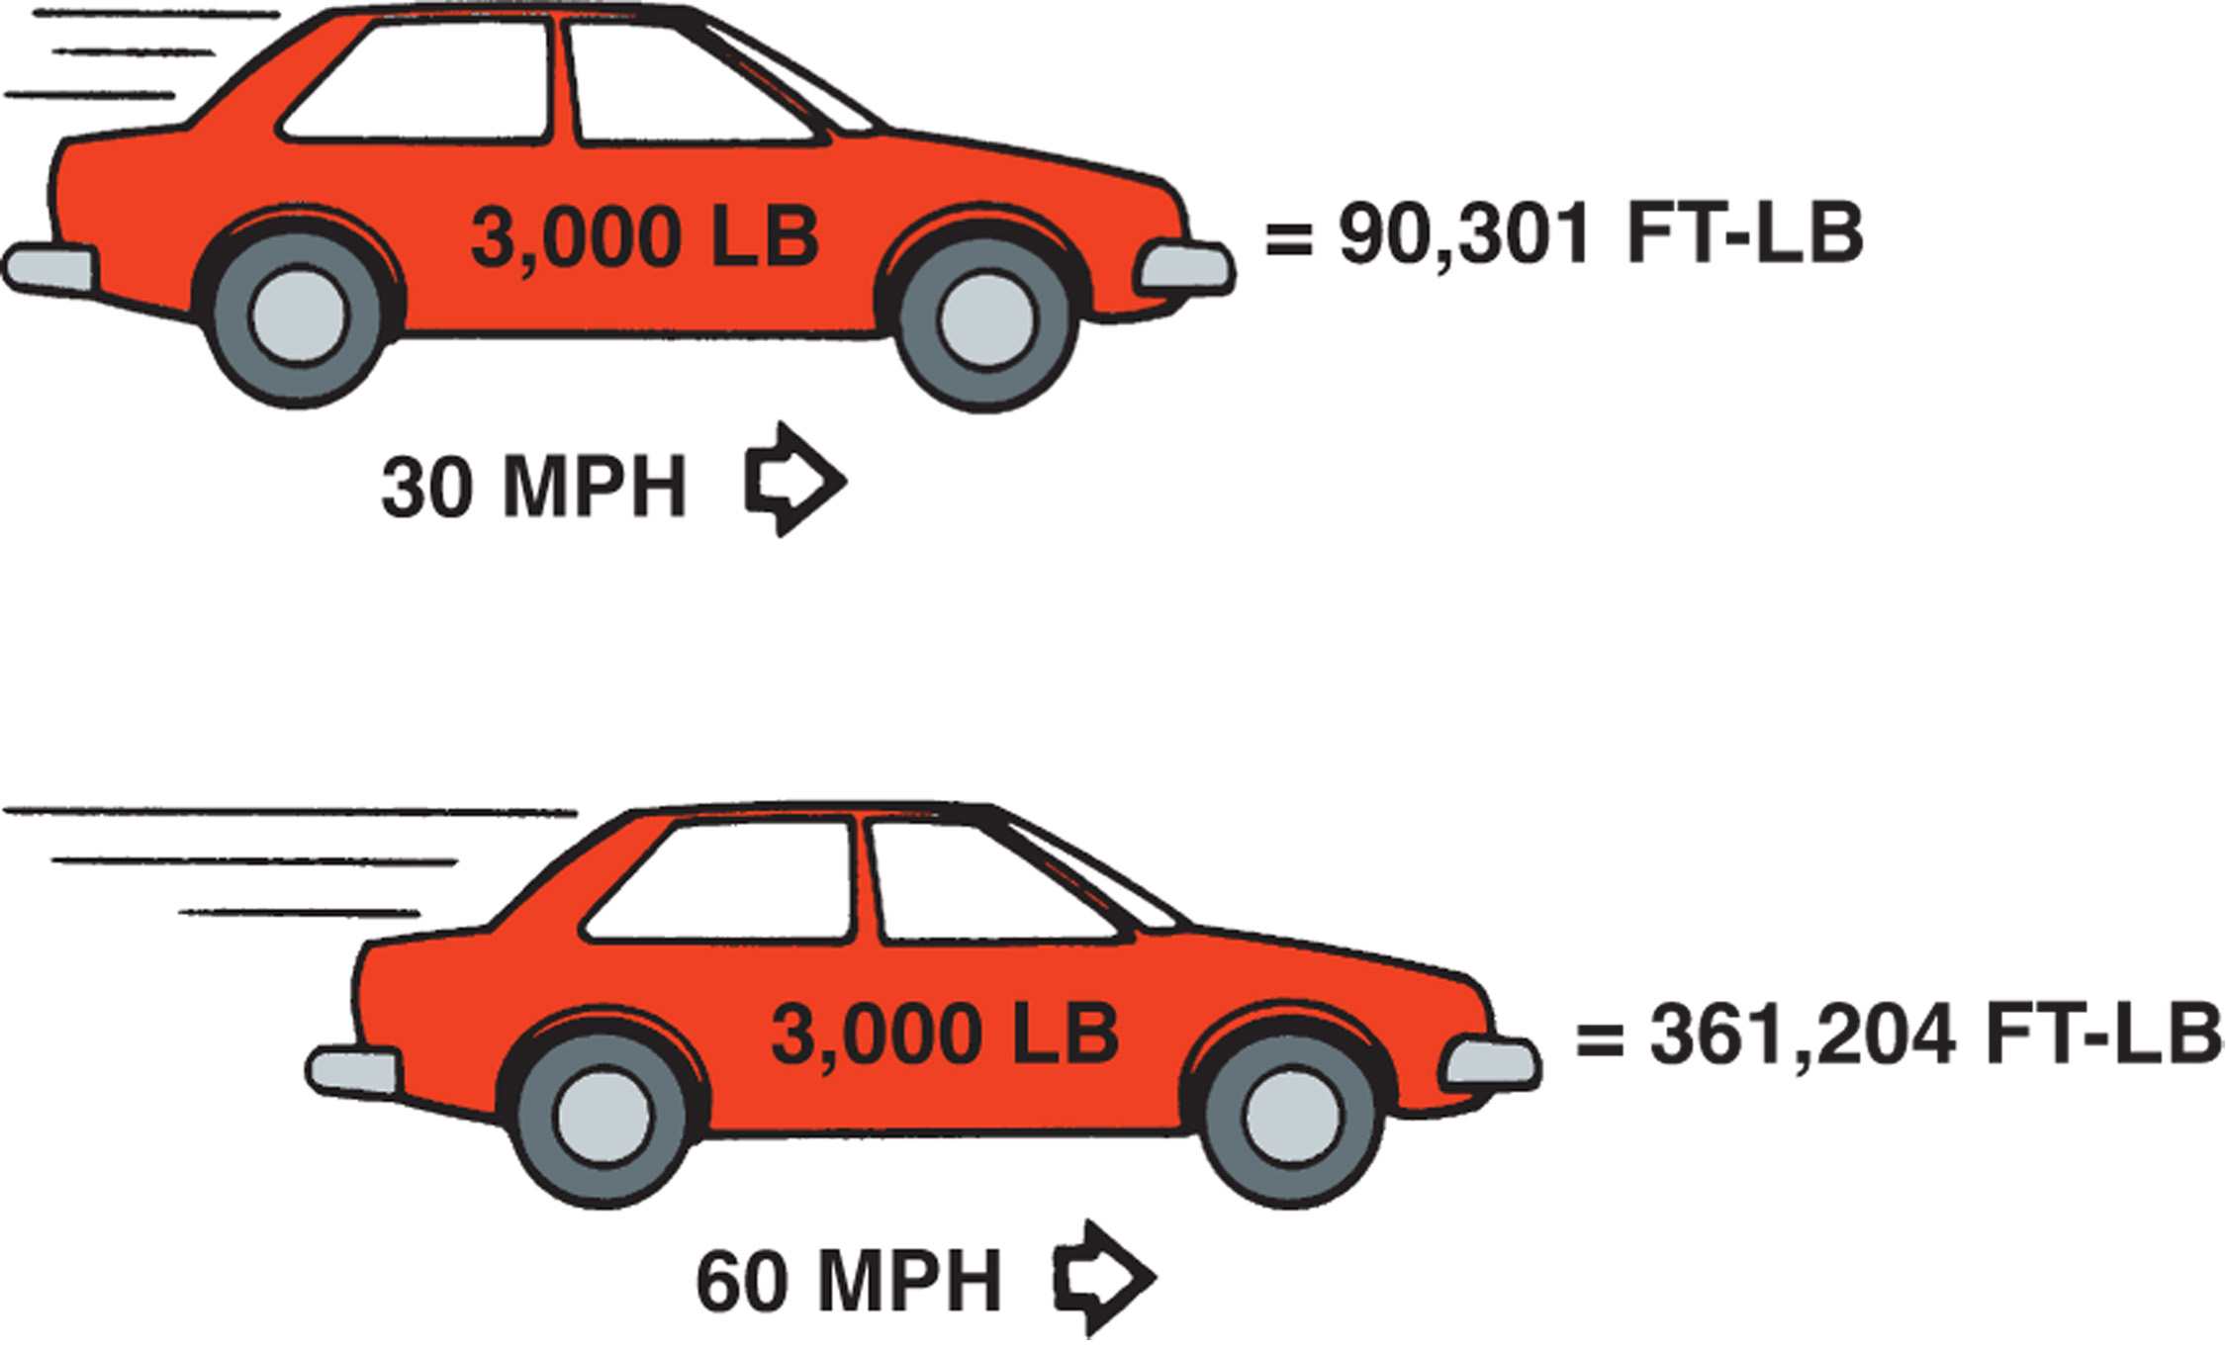
Figure 93-3 Kinetic energy increases as the square of any increase in vehicle speed.
Notes:
Figure 93-3 Kinetic energy increases as the square of any increase in vehicle speed.
11

Slide 12
INERTIA

Slide 13
Inertia
Defined by Newton’s First Law of Motion
  Body at rest tends to remain at rest
  Body in motion tends to remain in motion in a straight line unless acted upon by an outside force

Slide 14
Inertia
Weight Transfer
  Inertia, in form of weight transfer, plays major part in vehicle’s braking
  When brakes applied, only wheels and tires begin to slow immediately
  Rest of vehicle attempts to remain in forward motion
  Front suspension compresses, rear suspension extends, and weight transferred toward front of vehicle

Slide 15
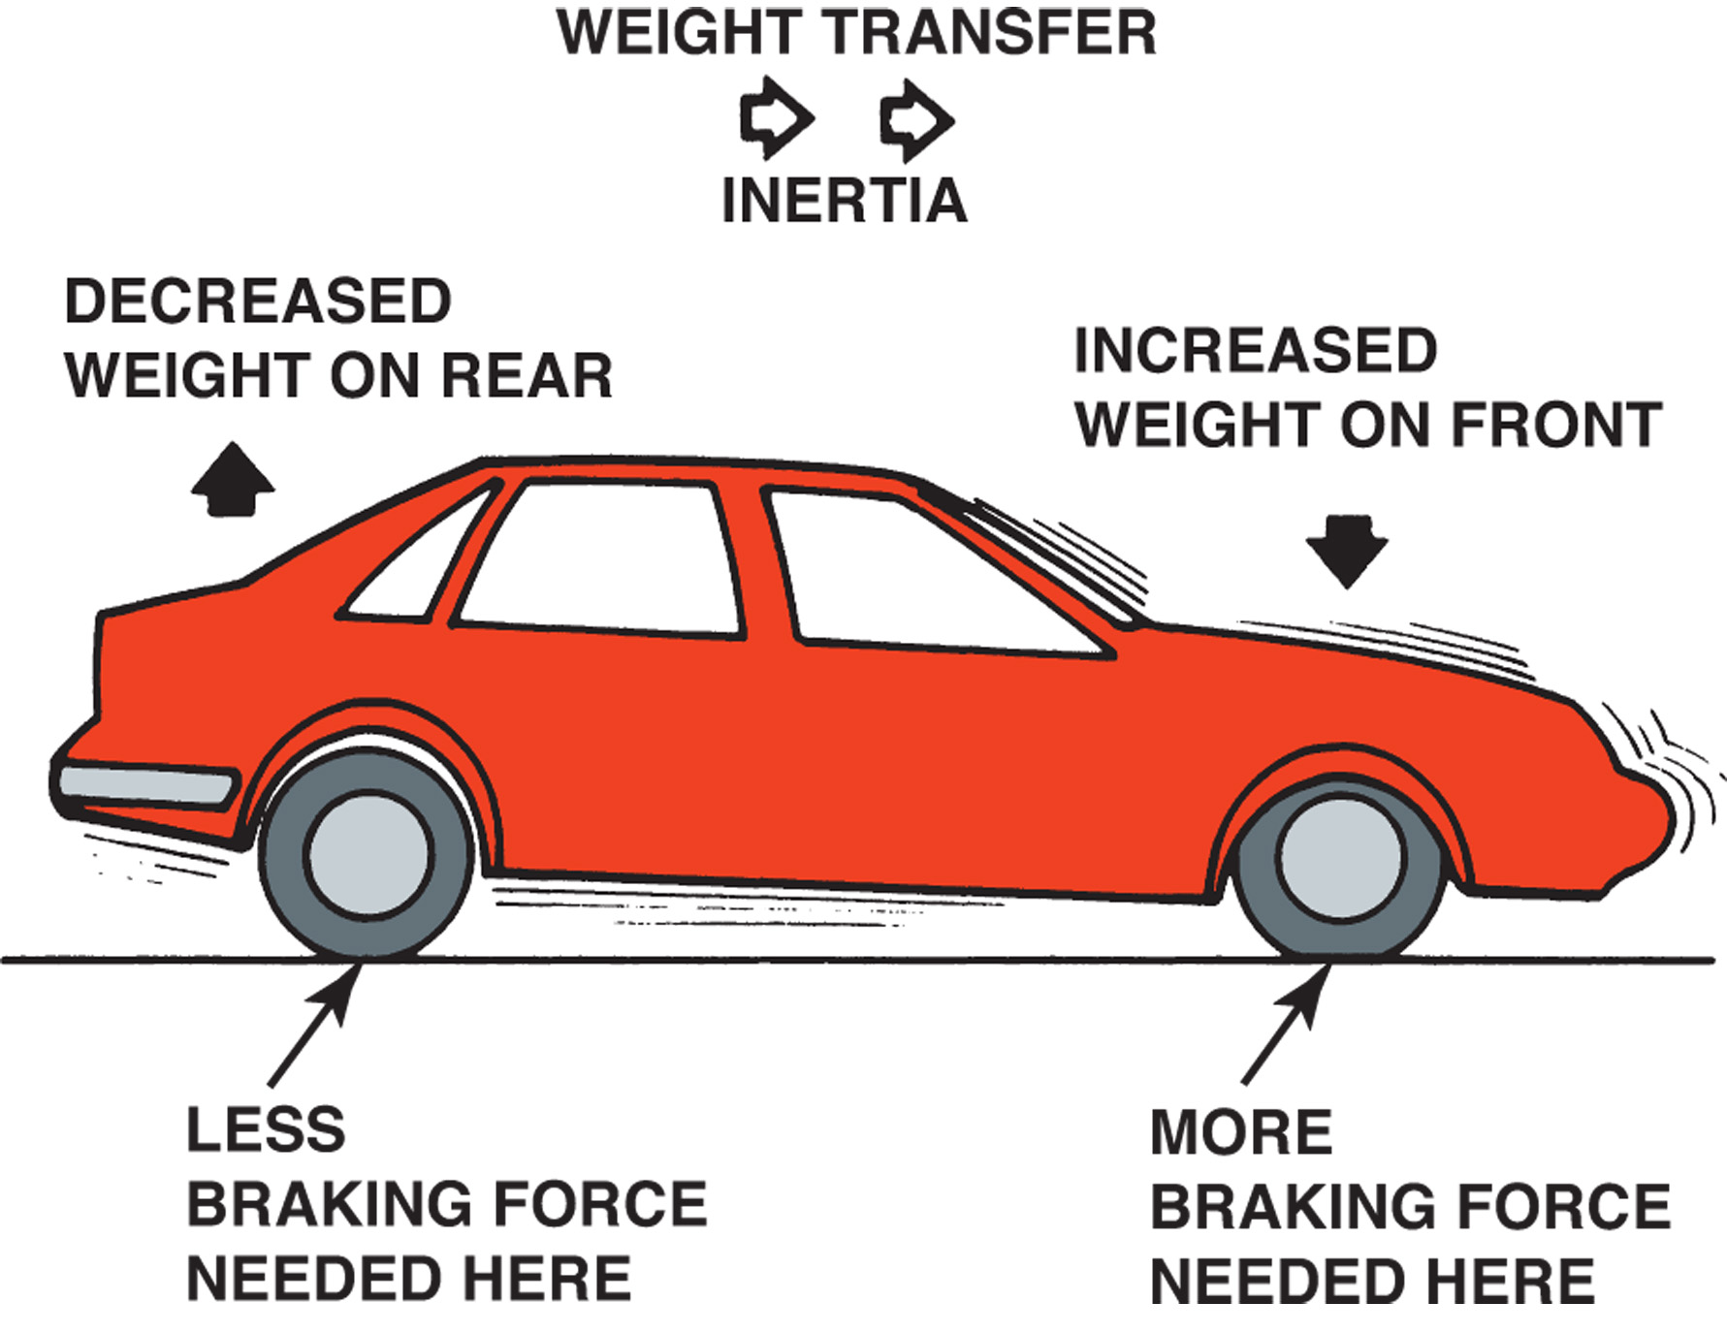
Figure 93-4 Inertia creates weight transfer that requires the front brakes to provide most of the braking force.
Notes:
Figure 93-4 Inertia creates weight transfer that requires the front brakes to provide most of the braking force.
15

Slide 16
Inertia
Weight Transfer
  Total weight of vehicle does not change, only amount supported by each axle
  Also, most vehicles have forward weight bias
    Even when stopped, more than 50% of weight supported by front wheels
    Most heavy parts are located toward front of the vehicle-

Slide 17
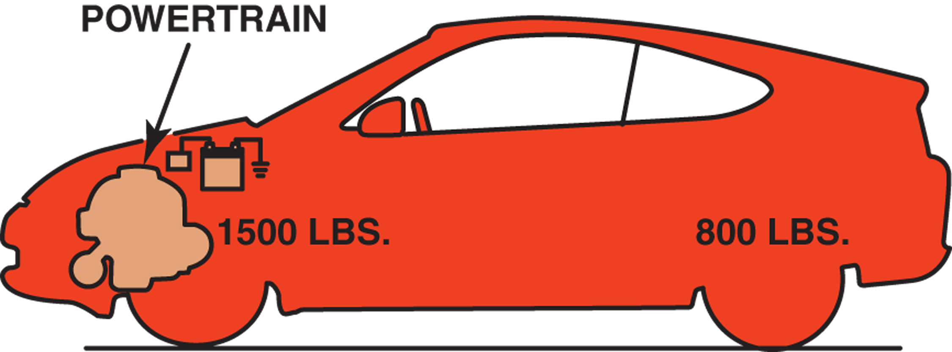
Figure 93-5 Front wheel drive vehicles have most of their weight over the front wheels.
Notes:
Figure 93-5 Front wheel drive vehicles have most of their weight over the front wheels.
17

Slide 18
Inertia
WHATS THIS GOT TO DO WITH BRAKES?
Weight Transfer Weight transfer greatly increases the load on the front wheels
  Requires front brakes to provide 80%–90% total braking force
  To deal with extra load, front brakes much more powerful than rear brakes

Slide 19

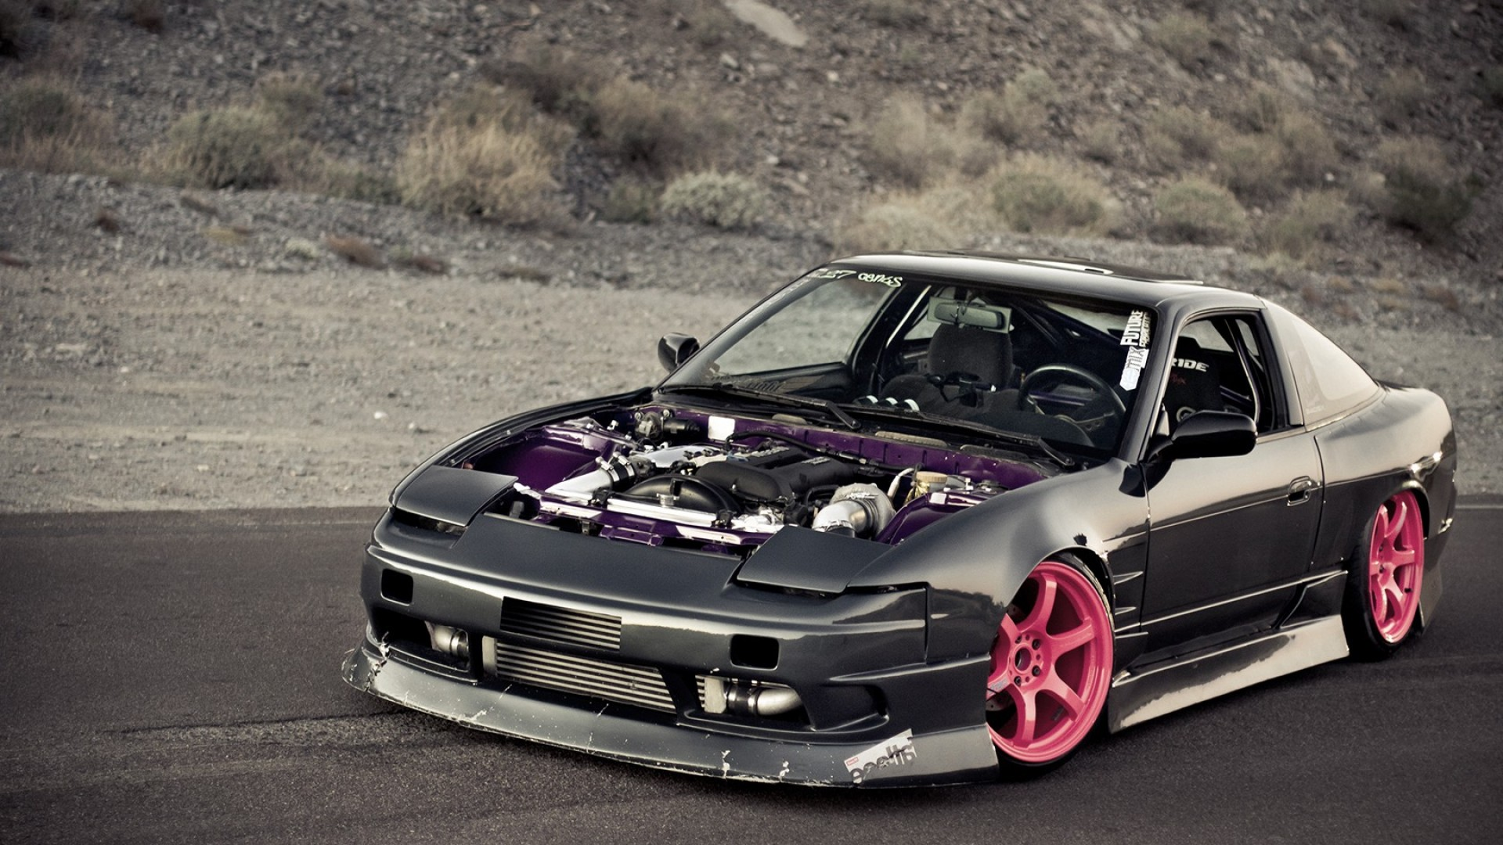
Inertia
Weight Transfer
      Some cars have 50/50 weight distribution

Slide 20
MECHANICAL PRINCIPLES

Slide 21
Mechanical Principles
Levers
  Leverage primary mechanical principle used to increase application force in every brake system
  Lever is simple machine that consists of rigid object, typically metal bar, that pivots about fixed point (fulcrum)

Slide 22
Mechanical Principles
Levers in Braking Systems
  Service brake pedal good example
    Pedal arm is lever
    Pivot point is fulcrum
  How it works?
    Force applied at foot pedal pad
    Force applied to master cylinder by pedal pushrod attached to pivot is much greater than force applied at pedal pad, but pushrod does not travel nearly as far

Slide 23
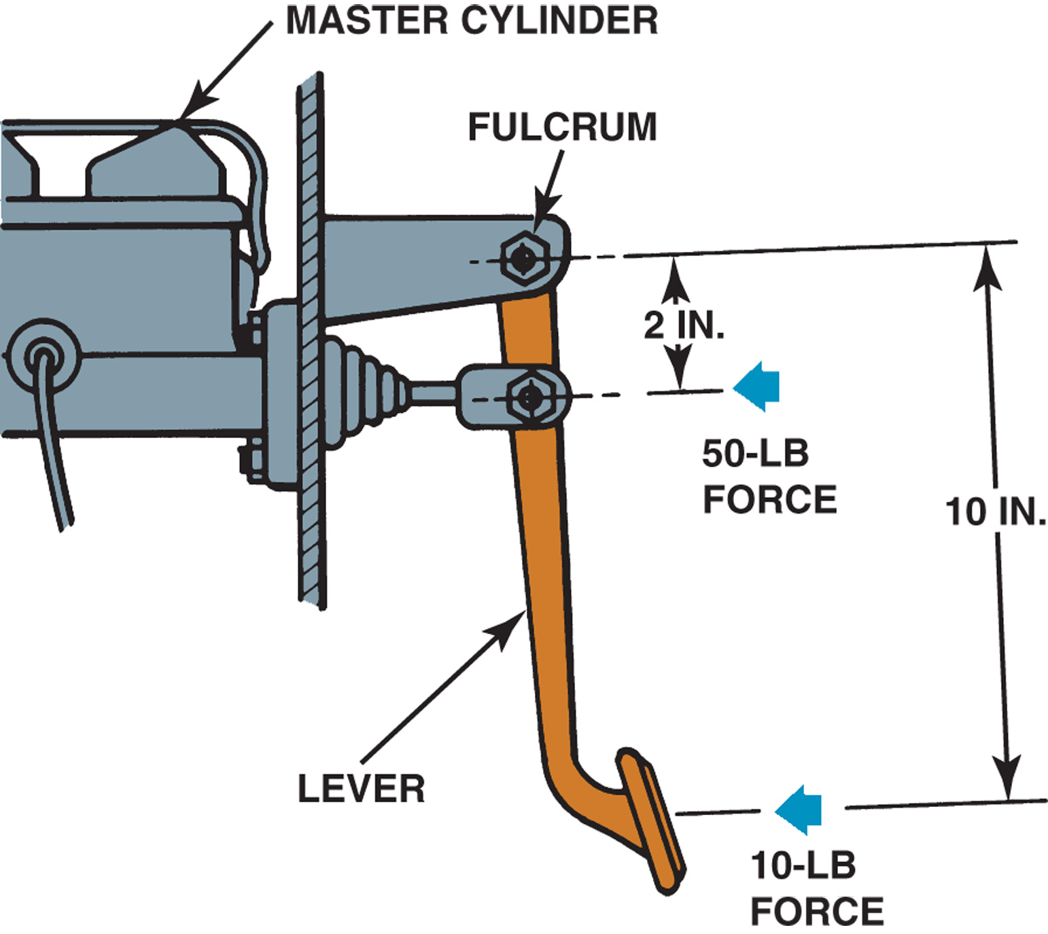
Figure 93-6 A brake pedal assembly is a second-class lever design that provides a 5 to 1 mechanical advantage.
Pedal Ratio
Notes:
Figure 93-6 A brake pedal assembly is a second-class lever design that provides a 5 to 1 mechanical advantage.
23

Slide 24
FRICTION PRINCIPLES

Slide 25

Friction Principles
Wheel brakes use friction to convert kinetic energy into heat energy
Friction is resistance to movement between two surfaces in contact
Brake performance is improved by increasing friction (to a point…)

Slide 26
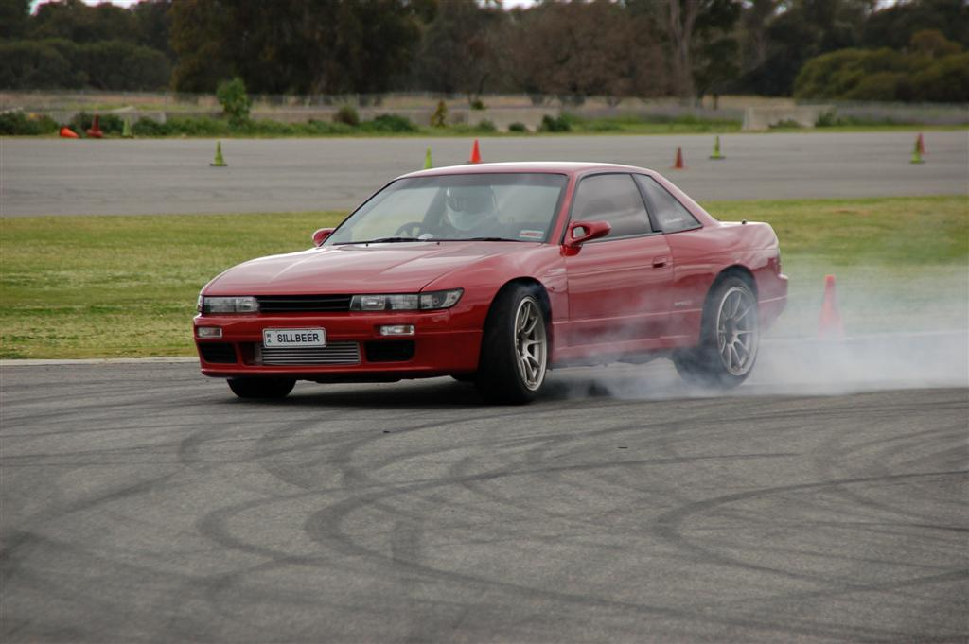
Friction Principles
Brakes are only as good as the tires…
We can increase clamping force on the rotor but that may not be the problem

Slide 27

Friction Principles
Coefficient of Friction
  Amount of friction between two objects expressed as coefficient of friction (μ)

Slide 28
Friction Principles
Surface Finish Effects
  If 100 lb force required to pull 200-lb wood block across concrete floor:
    Equation for coefficient of friction:
      100 lb/200 lb = 0.5

Slide 29
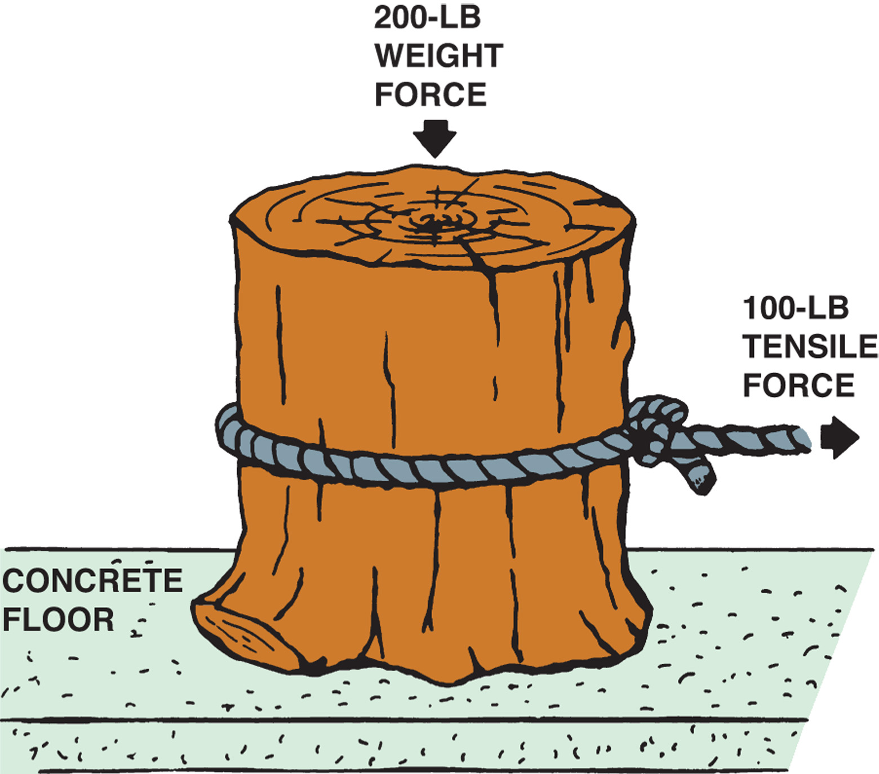
Figure 93-7 The coefficient of friction in this example is 0.5.
Notes:
Figure 93-7 The coefficient of friction in this example is 0.5.
29

Slide 30
Friction Principles
Surface Finish Effects
  Block of wood sanded smooth, improving surface finish and reducing force required to move it to only 50 lb
    Equation for coefficient of friction:
      50 lb/200 lb = 0.25

Slide 31
Friction Principles
Surface Finish Effects
  Coefficient of friction drops by half

Slide 32
Friction Principles
Friction Material Effects
  If 200-lb block of ice substituted for wood block
  Only 10-lb force needed to pull the block across concrete
    Equation for coefficient of friction:
      10 lb/200 lb = 0.05

Slide 33
Friction Principles
Friction Material Effects
  Coefficient of friction decreases dramatically
  Type of materials being rubbed together have very significant effect on coefficient of friction

Slide 34
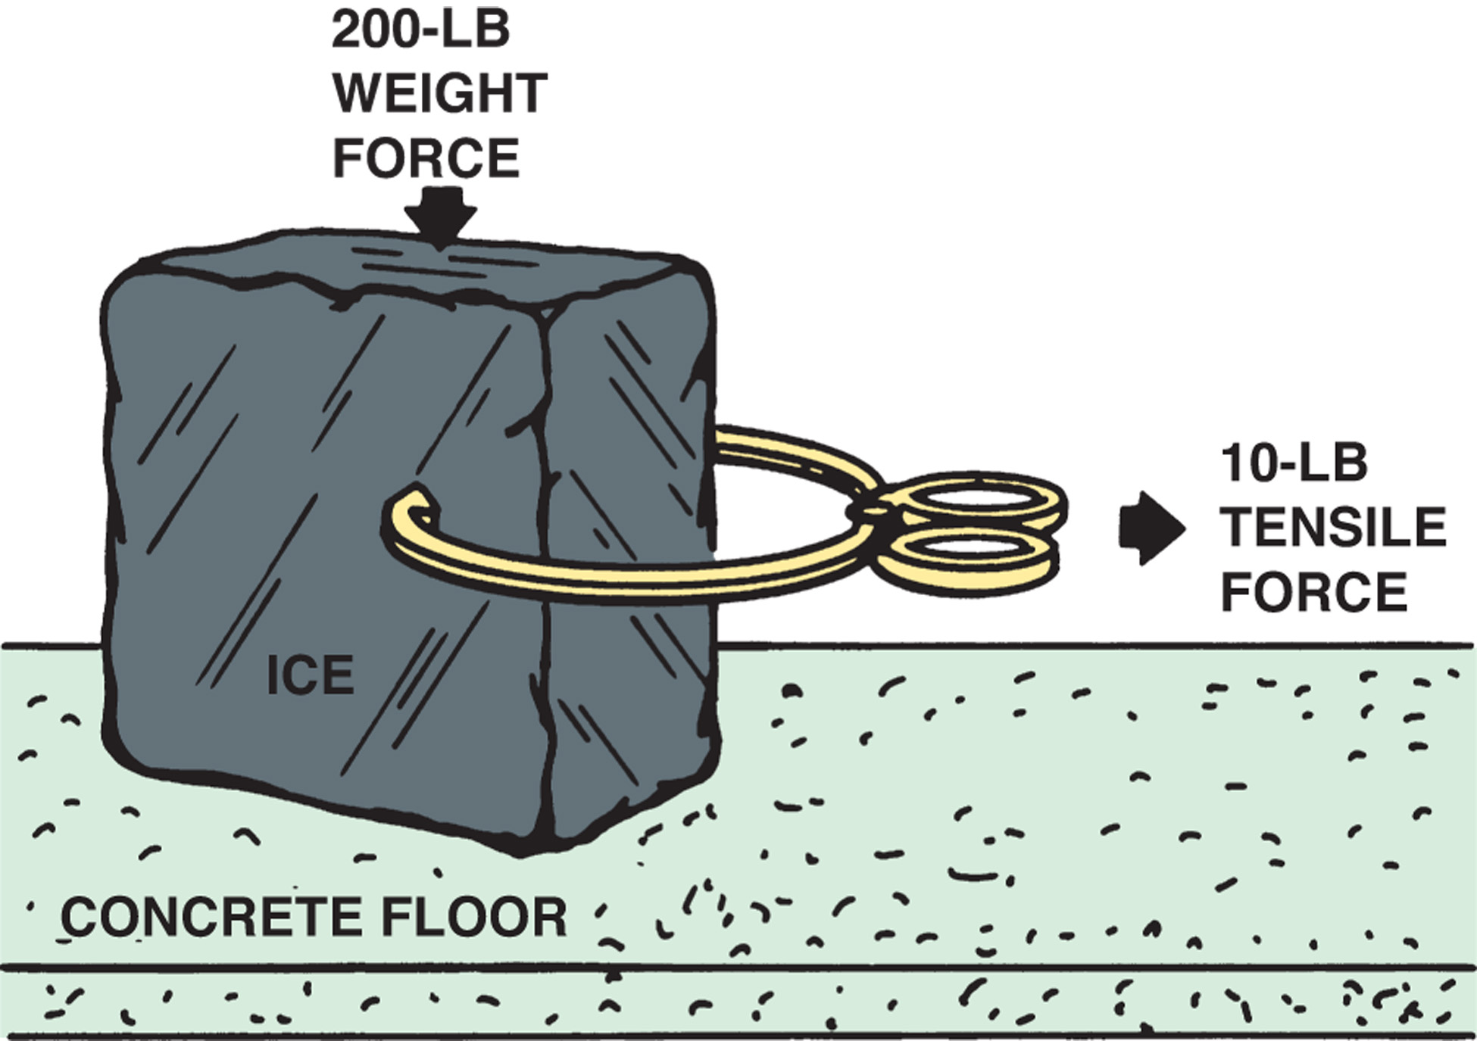
Figure 93-8 The type of friction material affects the coefficient of friction which is just 0.05 in this example.
Notes:
Figure 93-8 The type of friction material affects the coefficient of friction which is just 0.05 in this example.
34

Slide 35
Friction Principles
Friction Material Effects
  Iron and steel used most often for brake drums and rotors
    Relatively inexpensive; can stand up under extreme friction

Slide 36
Friction Principles
Friction Material Effects
  Brake lining material does not need as long a service life
    Brake shoe and pad friction materials play major part in determining coefficient of friction
    Several fundamentally different materials to choose from

Slide 37
Friction Principles
Friction Contact Area
  Tires are example where contact area makes difference
  All other things being equal, wide tire with large contact area on road has higher coefficient of friction than narrow tire with less contact area

Slide 38
Friction Principles
Friction Contact Area
  Tire conforms to and engages road surface
  During hard stop, portion of braking force comes from tearing away tire tread rubber

Slide 39
Friction Principles
Friction Contact Area
  Rubber’s tensile strength (internal resistance to being pulled apart) adds to braking efforts of friction

Slide 40
Friction Principles
Static and Kinetic Friction
  Static value: coefficient of friction with two friction surfaces at rest
  Kinetic value: coefficient of friction while two surfaces sliding against one another

Slide 41
Friction Principles
Static and Kinetic Friction
  Coefficient of static friction always higher than of kinetic friction
    Explains why harder to start object moving than keep it moving

Slide 42
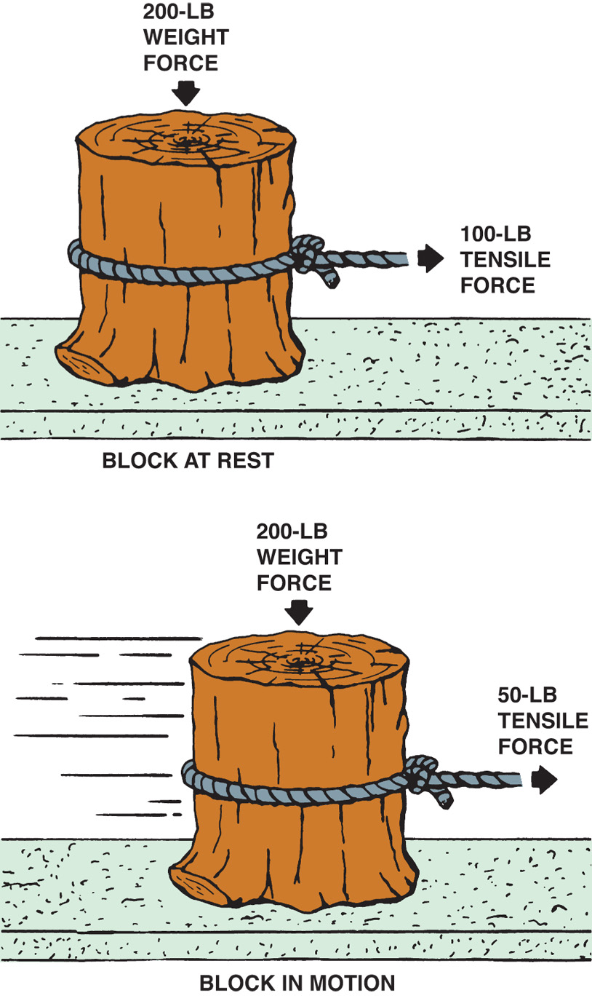
Figure 93-9 The static coefficient of friction of an object at rest is higher than the kinetic (dynamic) friction coefficient once in motion.
Notes:
Figure 93-9 The static coefficient of friction of an object at rest is higher than the kinetic (dynamic) friction coefficient once in motion.
42

Slide 43
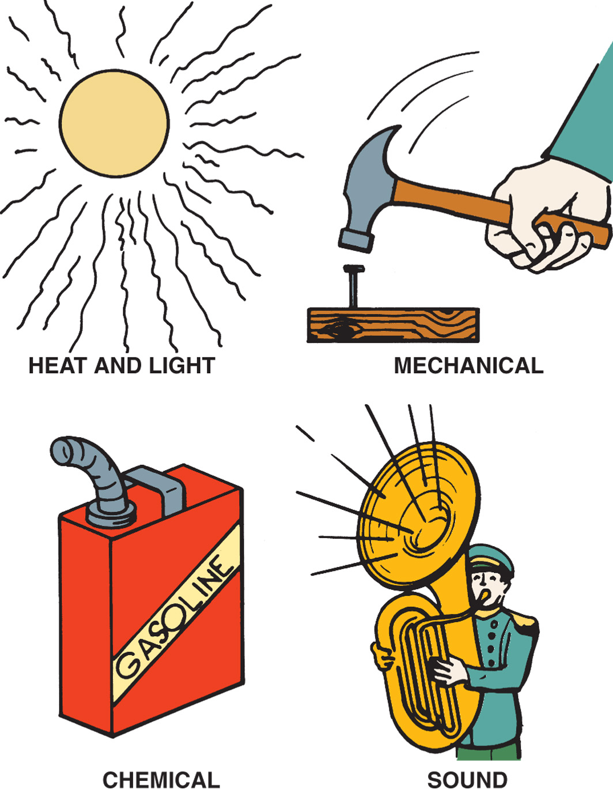
Figure 93-1 Energy which is the ability to perform work exists in many forms.
Notes:
Figure 93-1 Energy which is the ability to perform work exists in many forms.
43

Slide 44
FRICTION AND HEAT

Slide 45
Friction and Heat
Function of brake system to convert kinetic energy into heat energy through friction
Change in kinetic energy determines amount of temperature increase

Slide 46
Friction and Heat
Faster and heavier a vehicle is, the more heat to be dissipated by brake system
Thicker and heavier the brake rotors and drums, the more heat they can absorb

Slide 47
DECELERATION RATES

Slide 48
Deceleration Rates
Deceleration rates measured in units of “feet per second per second”
  Abbreviated “ft/sec²” or m/sec²

Slide 49
Deceleration Rates
Typical Deceleration Rates
  Comfortable deceleration about 8.5 ft/sec² (3 m/sec²)
  Loose items in vehicle will “fly” above 11 ft/sec² (3.5 m/sec²)
  Maximum deceleration rates for most vehicles and light trucks: 16–32 ft/sec² (5–10 m/sec²)

Slide 50
Deceleration Rates
Typical Deceleration Rates
  Average deceleration rate of 15 ft/sec² (3 m/sec²) can stop a vehicle traveling at 55 mph (88 km/h) in about 200 ft (61 m) in less than 4 seconds
    Standard brake system test
      Vehicle braked at this rate 15 times

Slide 51
Deceleration Rates
Typical Deceleration Rates
  Average deceleration rate of 15 ft/sec² (3 m/sec²) can stop a vehicle traveling at 55 mph (88 km/h) in about 200 ft (61 m) in less than 4 seconds
    Standard brake system test
      Front brake pad temperatures can reach 1,300°–1,800°F (700°–980°C)

Slide 52
Deceleration Rates
Typical Deceleration Rates
  Average deceleration rate of 15 ft/sec² (3 m/sec²) can stop a vehicle traveling at 55 mph (88 km/h) in about 200 ft (61 m) in less than 4 seconds
    Standard brake system test
      Brake fluid and rubber components may reach 300°F (150°C) or higher

Slide 53
TECH TIP
BACK TO
PRESENTATION
Brakes Cannot Overcome the Laws of Physics
  No vehicle can stop on a dime. The energy required to slow or stop a vehicle must be absorbed by the braking system. All drivers should be aware of this fact and drive at a reasonable speed for the road and traffic conditions.

