Slide 1
VEHICLE IDENTIFICATION AND EMISSION RATINGS
16

Slide 2
Objectives
The student should be able to:
Identify a vehicle.
Interpret vehicle identification numbers and placard information.
Interpret vehicle emissions and emission control information.
Read and interpret casting numbers.
Locate calibration codes.

Slide 3
Parts of a Vehicle
Left Side of the Vehicle–Right Side of the Vehicle
Refer to left and right as if driver is sitting behind steering wheel
Left side (including components under hood) is on driver’s side
Front and Rear

Slide 4
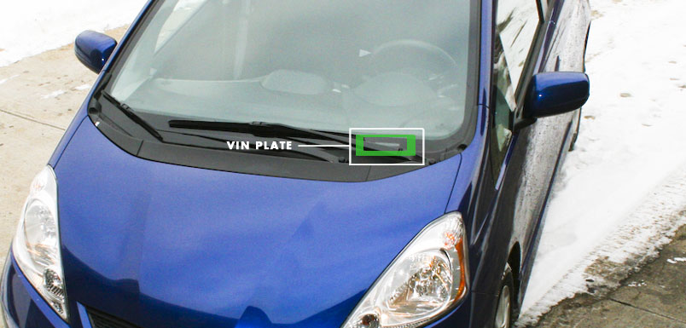
Vehicle Identification Number
VIN
Found on the dash in front of the driver, the frame, the engine, the transmission and on the paperwork.
Started being used in the US in 1954
NHTSA required all cars have a 17 number VIN in 1981
1994 required all frequently stolen parts be marked with the VIN

Slide 5
The first three characters The WMI
The World Manufacturer Index was adopted in 1977 and revised in 1983
1st character is a world region
2nd character is a country
3rd character is a manufacturer
Some big American manufacturers use their own 2nd and third numbers

Slide 6
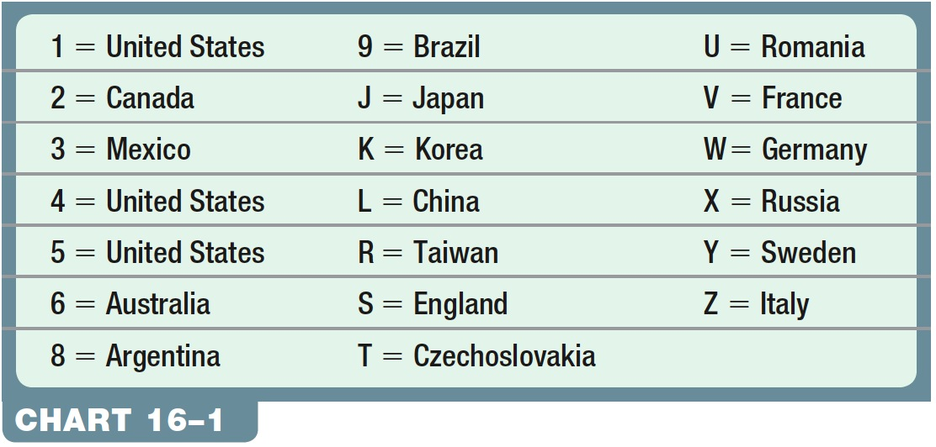
Examples
SAJ – S=Europe, A=UK, J=Jaguar
1G2 – United States, General Motors, Pontiac
1FT – United States, Ford, Truck
3FA – Mexico, Ford, Passenger car

Slide 7
The next 4
4-7 are manufacturers specific codes.
Many use the numbers for body type – coupe, sedan, convertible
Transmission and engine configurations are also common
Trim levels are sometimes included

Slide 8
8th
Very often the Engine Code
Very important to ordering parts and finding out if your car has one type of engine or not.

Slide 9
Check digit
Can only be 0-9 or X

Slide 10
Big Number 10
Vehicle Model year.
Any time after Jan 1, the next model year can come out.
Most model years start in September of the previous year.
A=1980 Y=2000 no I, O, or Q used.
2001 and on is numerical starting with 1

Slide 11
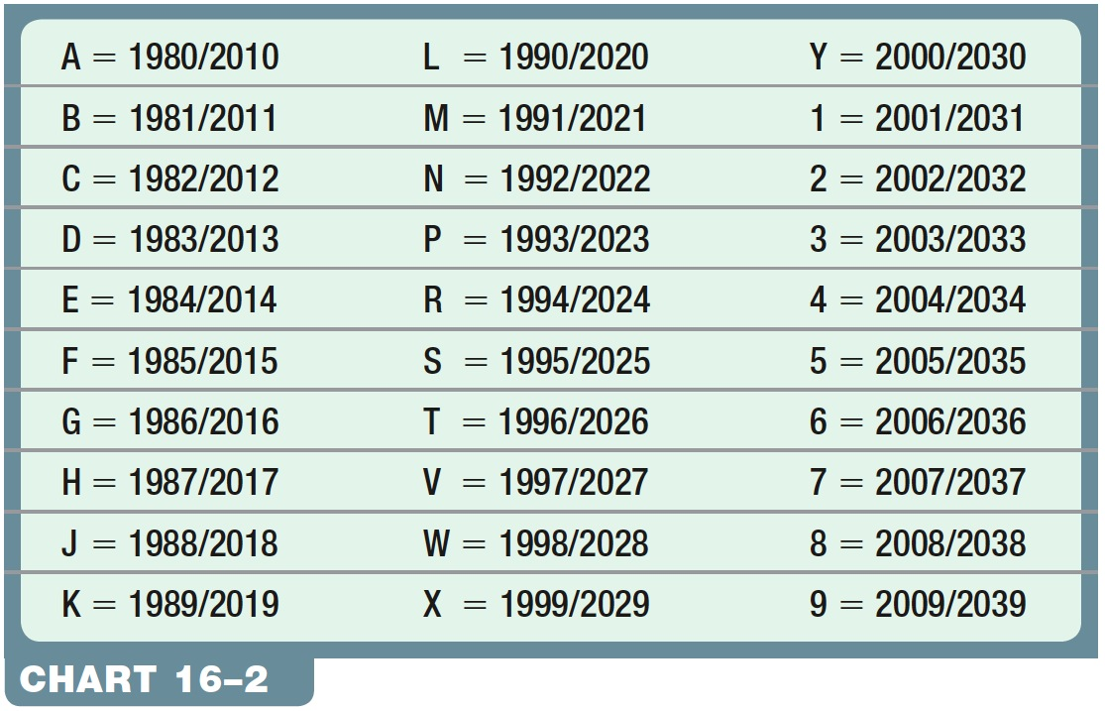
Chart 16-2 VIN Year Chart (The Pattern Repeats Every 30 Years)
Notes:
Chart 16-2 VIN Year Chart (The Pattern Repeats Every 30 Years)

Slide 12
11th character
Vehicle assembly plant
Ford’s G plant is the Chicago, IL plant

Slide 13
12-17
Sequential build numbers
Might not start with 0. Many start with a different first digit.

Slide 14
1FAFP90S55Y400001
1=NA F=Ford A=Passenger car
F = Active seat belts, 2 air bags
P90 = GT base model
S = 5.4L DOHC Supercharged 500 hp
5 check digit
5= 2005 model year
Y = built in Wixom, MI
400001 = 1st car off the production line

Slide 15
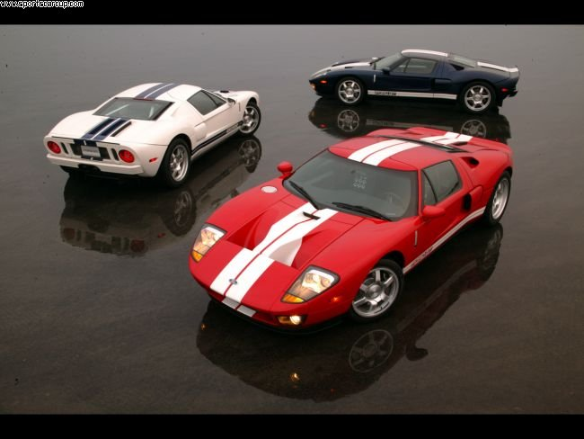
First car sold to the public was number 400010. It sold at auction for $557,500.

Slide 16
Door sticker - Important info
Date of manufacture
Tire type and pressure
GVWR
Paint, options, axle ratio, transmission type, interior trim etc.
www.myf150.com/howto/decode.php

Slide 17
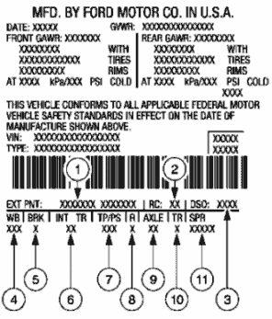
Figure 16-2 A VECI label on a 2008 Ford.
1 -Exterior Paint Code
2 -Region Code
3 -Domestic SpeciaOrder Code
4 -Wheelbase Code
5 -Brake Code
6 -Interior Trim Code
7 -Tape/Paint Pinstripe Code
8 -Radio Code
9 -Axle Code
10 -Transmission Code
11 -Spring Code
Notes:
Figure 16-2 A VECI label on a 2008 Ford.

Slide 18
Emissions sticker
Engine size
Engine code name or family name
Timing adjustment procedures
Vacuum diagrams
What emissions regulations it conforms to

Slide 19
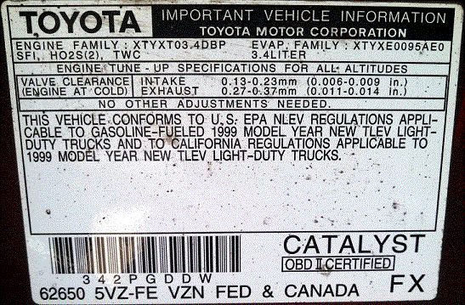
Figure 16-2 A VECI label on a 2008 Ford.
Notes:
Figure 16-2 A VECI label on a 2008 Ford.

Slide 20
Figure 15-1 The owner’s manual has a lot of information pertaining to the operation as well as the maintenance and resetting procedures that technicians often need.
Notes:
Figure 15-1 The owner’s manual has a lot of information pertaining to the operation as well as the maintenance and resetting procedures that technicians often need.

Slide 21
Electronic Service Information
Software programs with service information for many vehicles
ALLDATA and Mitchell On-Demand commonly used programs
Service information and testing procedures should be closely followed
Any symptom charts or flow charts

Slide 22
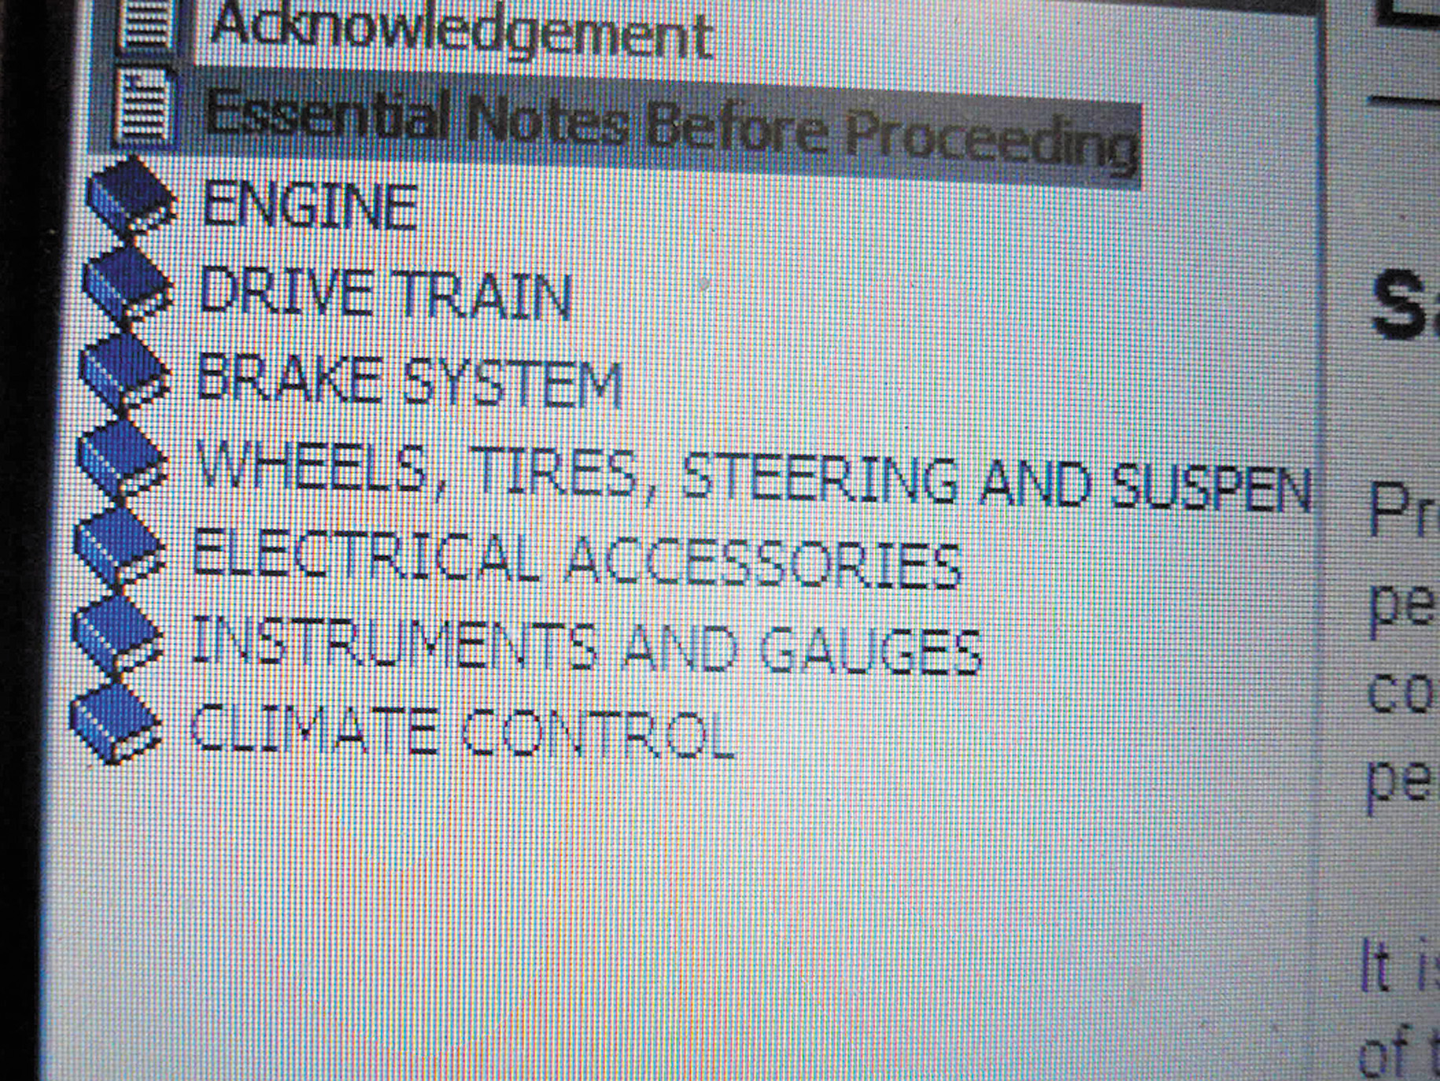
Figure 15-3 A main menu showing the major systems of the vehicle. Clicking on one of these major topics opens up another menu showing more detailed information.
http://repair.edu.alldata.com
Notes:
Figure 15-3 A main menu showing the major systems of the vehicle. Clicking on one of these major topics opens up another menu showing more detailed information.

Slide 23
Under Hood checks Basic Car Care, Maintenance, and Repair
Fluid Level/Condition Check

Slide 24
Fuel for Thought
Why is it best to check engine oil when the engine is luke warm?
What fluids should be checked on an automobile?
How can you use the color of a fluid to your advantage?

Slide 25
Objectives
Upon completion of this chapter and activities, you will be able to:
Identify different types of fluids used in the automobile.
Analyze fluid conditions.
Perform basic fluid level checks.

Slide 26
Common Fluid Locations

Slide 27
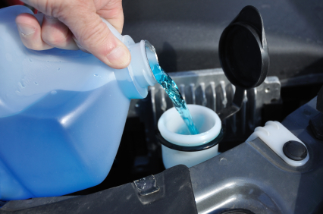
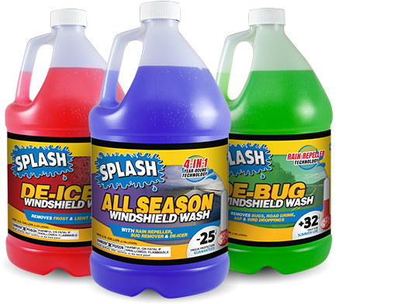
Windshield Washer Fluid
Commonly blue
Do not use engine antifreeze

Slide 28
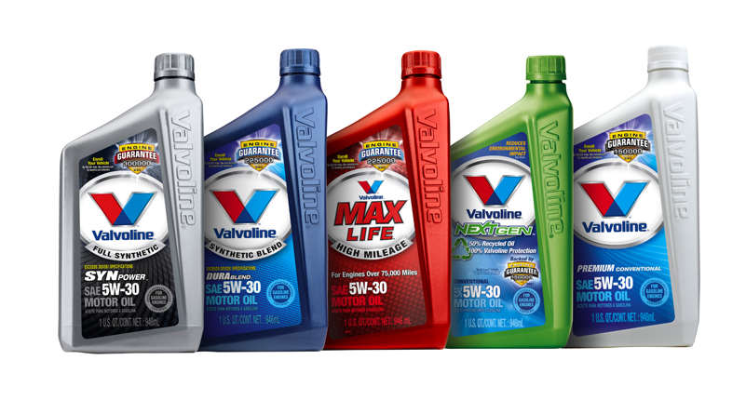
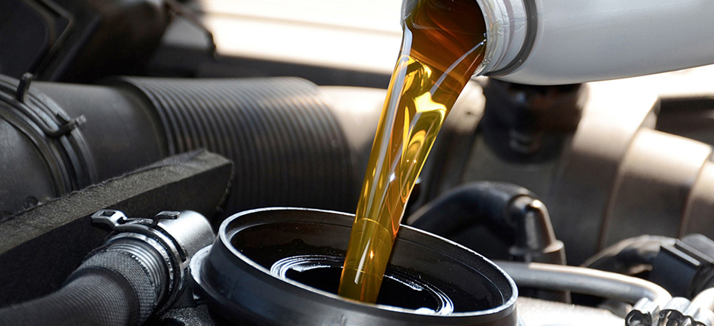
Engine Oil
Common multigrades are 5W-20, 5W-30, and 10W-30.
Synthetic and semi-synthetic blends are also available.

Slide 29
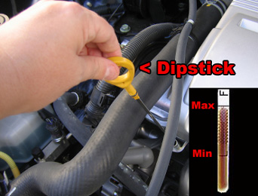
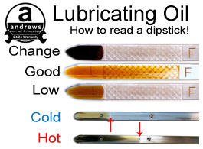
Engine Oil
To get an accurate reading, check when the engine is cold.

Slide 30
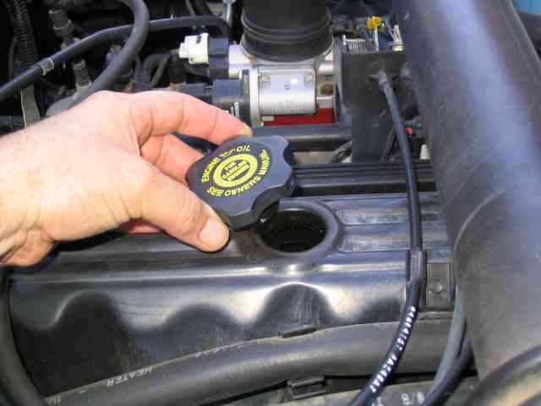
Engine Oil
Check the oil cap and owner’s manual for engine oil information.

Slide 31
Transmission Fluid
The most common automatic transmission fluid is Dexron/Mercon®.

Slide 32
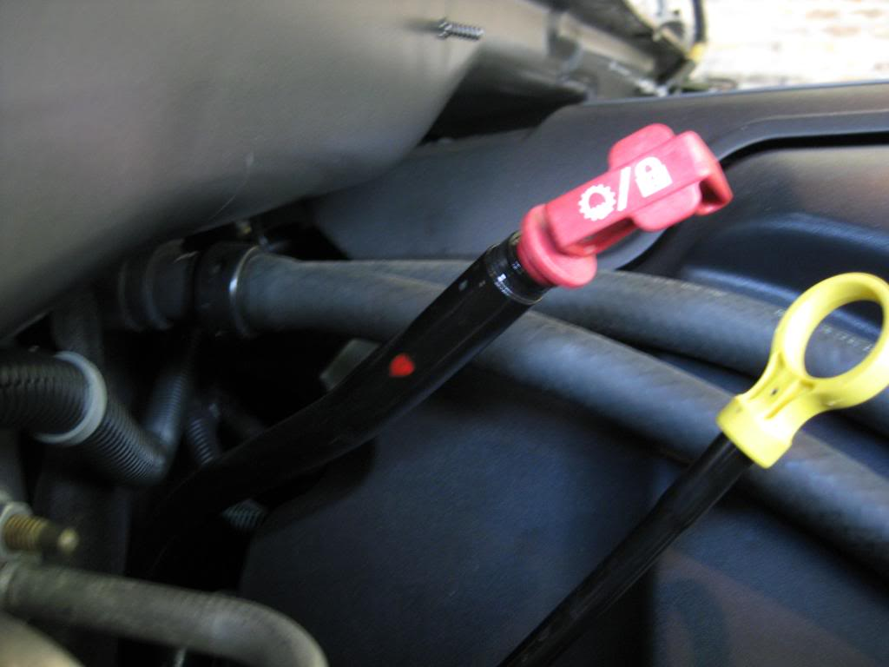
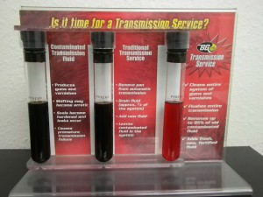
Transmission Fluid
Follow checking procedure in owner’s manual.

Slide 33
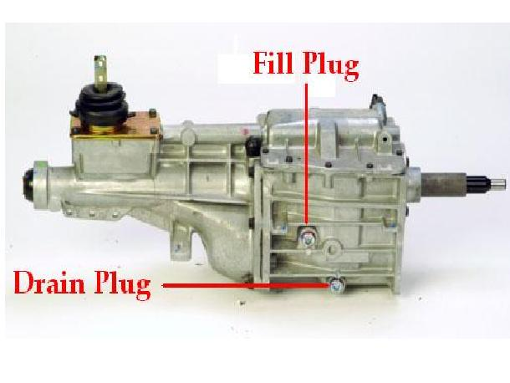
Transmission Fluid
Manual transmission commonly take ATF, heavyweight/high-viscosity gear oil, or motor oil.

Slide 34
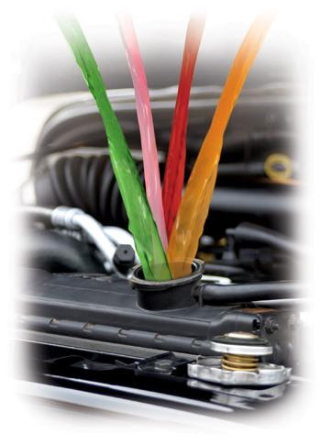
Coolant
Coolant - two main types
Standard (green)
Extended life (commonly orange, but also other colors)
Mix 50% water/50% antifreeze
Never open a hot radiator cap
Ethyl Glycol
Dex-Cool

Slide 35
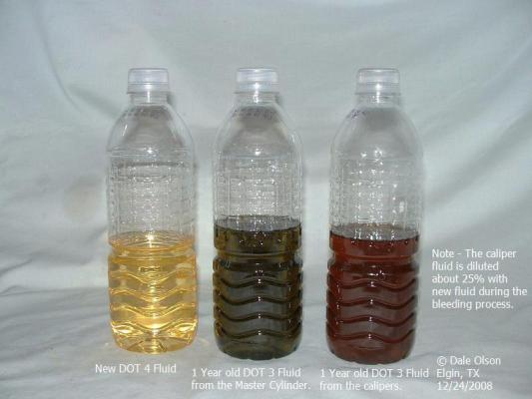
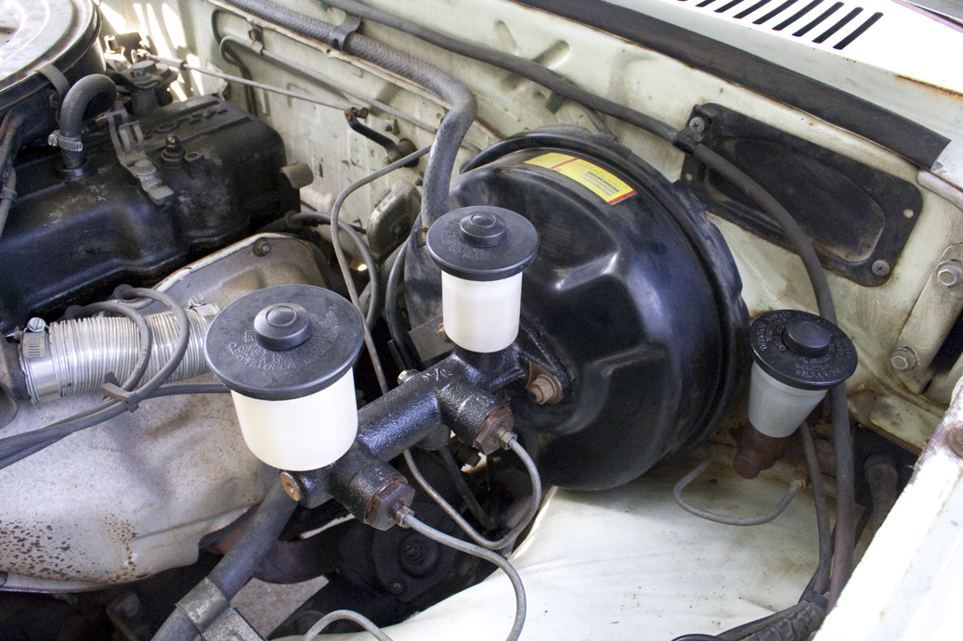
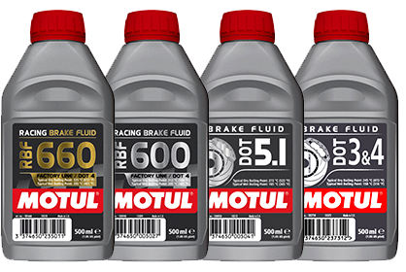
Brake Fluids
Most common DOT 3 (but DOT 4, DOT 5, and DOT 5.1 are available)

Slide 36
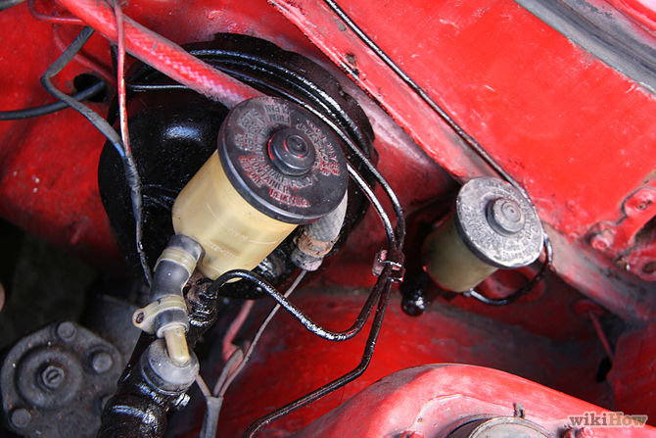
Clutch Fluid (manual transmissions only)
Commonly DOT 3 brake fluid, but always check the owner’s manual.

Slide 37
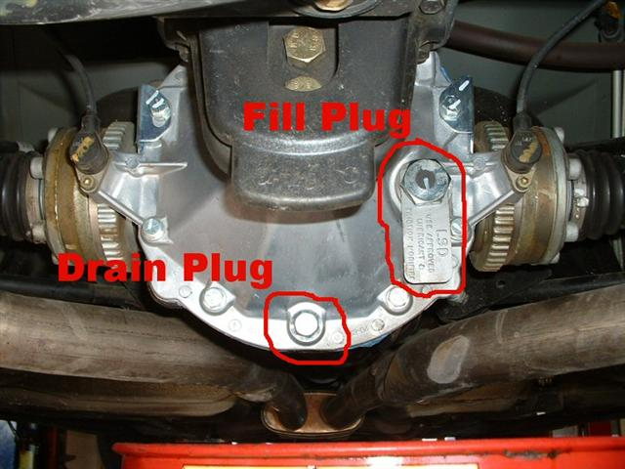
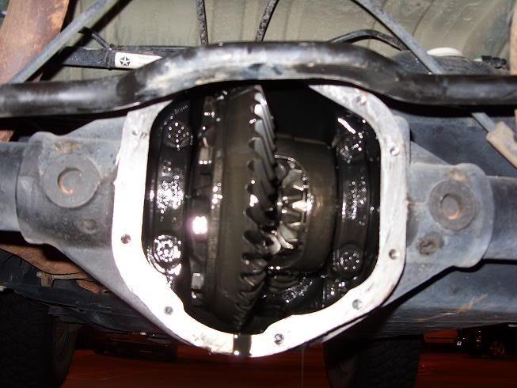
Differential Fluid
This fluid check is on RWD and 4WD vehicles.
4WD trucks will have front and rear differential check plugs.
Gear oil

Slide 38
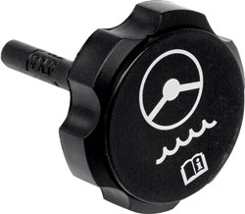
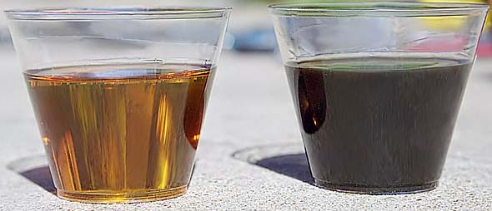
Power Steering Fluid
Use the type that is recommended in your owner’s manual.

Slide 39
Battery
Wear safety goggles and gloves.

Slide 40
Summary
Do not run fluids low; but also don’t overfill.
Always refer to the owner’s manual for fluid specifications.
Dispose of fluids properly.

