Slide 1
Oil and Oil changes
Secrets to Success

Slide 2
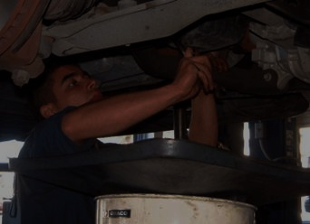
Why should YOU change your oil
So you know it’s done right
So you can monitor all of the other parts for wear and breakage
Because Jiffy Goobers get paid to work as fast as possible and to build the bill as high as possible

Slide 3
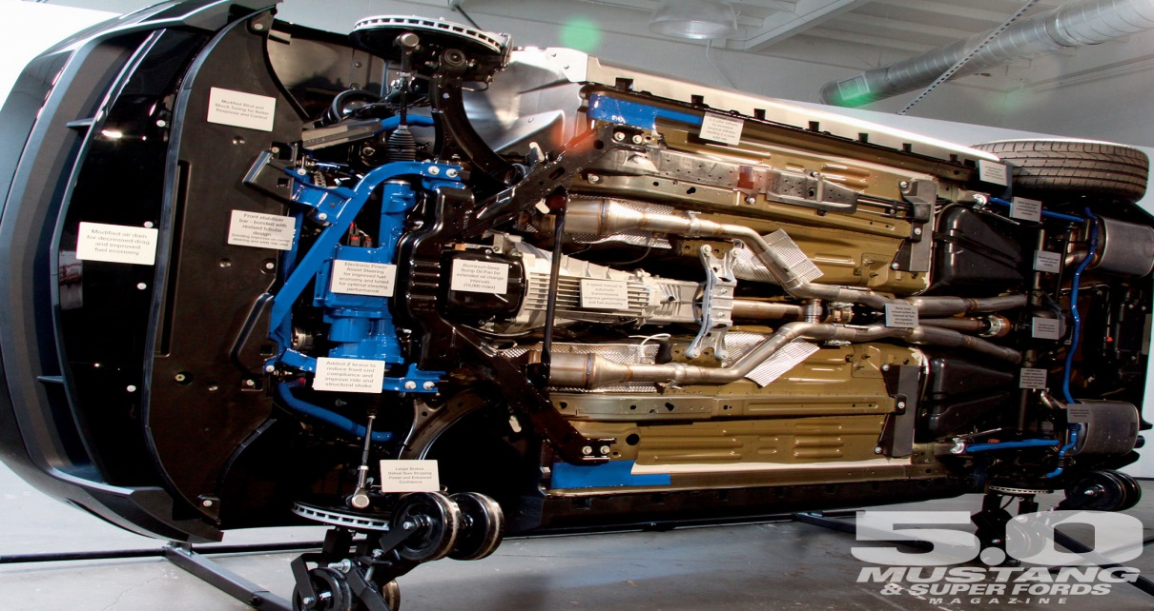
Why should you change your oil?
Oil changes are the single most important maintenance job to prolong the life of your car
They are easy..
Like, very easy!
They give you the opportunity to monitor all the rest of the systems on a regular basis

Slide 4
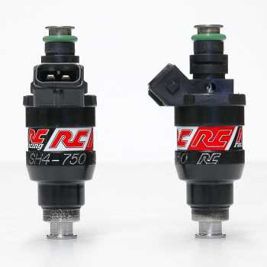
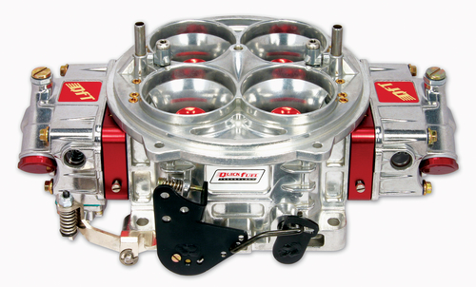
How often should you change your oil?
Carbureted cars – 3,000 miles or 3 months
Fuel injected cars – 5-7,000 miles or 4 months
Severe driving = change more often
Short trips, idling, dusty conditions are severe driving

Slide 5
What does oil do?
It keeps the parts from touching each other
It provides a slippery film between the parts
It reduces friction that causes wear and heat
It cleans the engine
It cools the engine
It prevents corrosion inside the engine
What if our engine is low on oil? How bad is that?

Slide 6
The oil pan
Made from stamped steel or cast aluminum
Mounted on the bottom of the engine
Catches oil draining down from the engine
Some have a windage tray or baffles to keep the oil contained when the car changes direction or speed
The drain plug is in the bottom of the pan

Slide 7
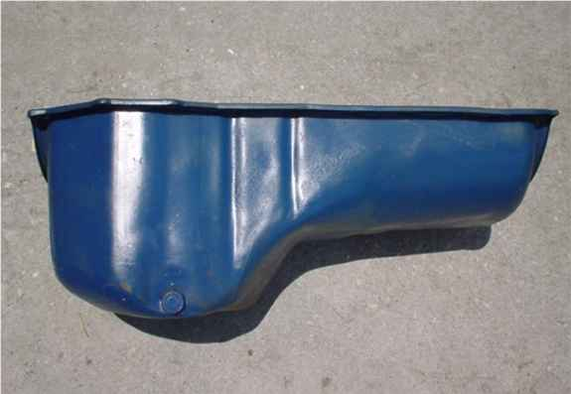
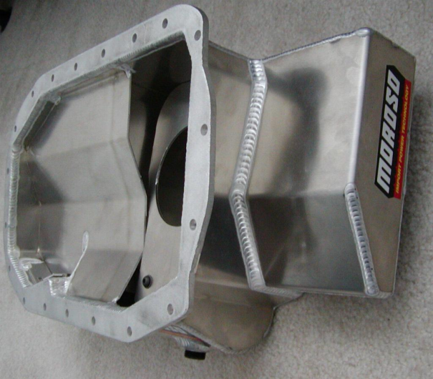
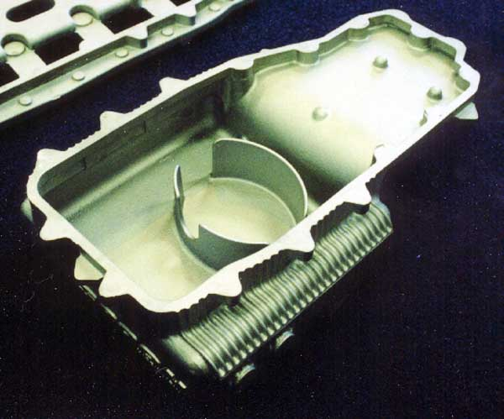
Oil pan types

Slide 8
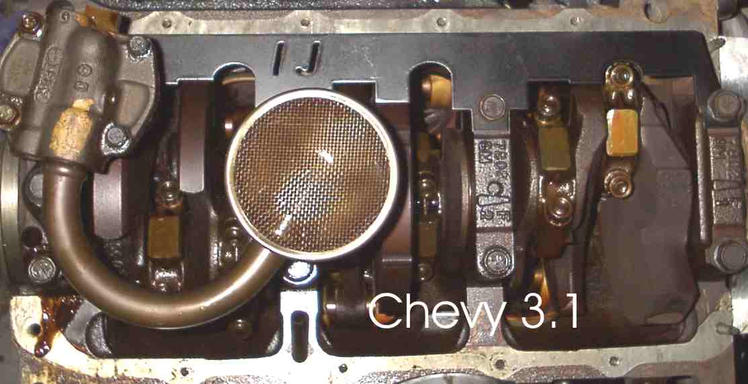
Oil pump
Picks up oil through the pick up tube and pumps it through the engine

Slide 9
Oil filter
Gets oil from the pump and runs it through a fine mesh
Traps particulate matter and stores it
Will bypass when full to prevent engine from starving for oil
Should be replaced with every oil change

Slide 10
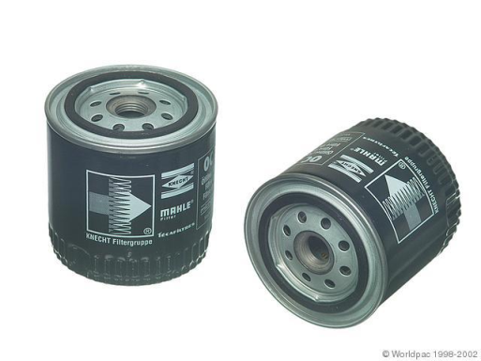
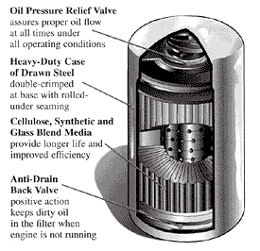
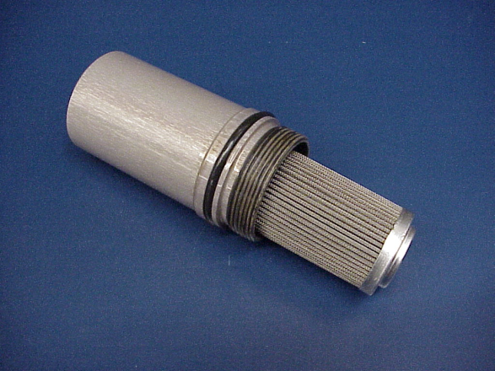
Oil filters

Slide 11
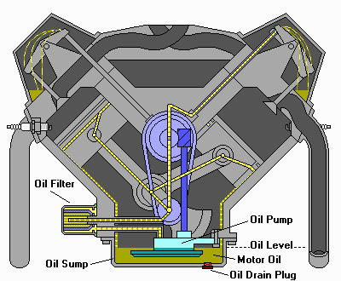
Distribution system
All the passage ways that send the oil under pressure to the moving parts then allow it to drain back into the pan

Slide 12
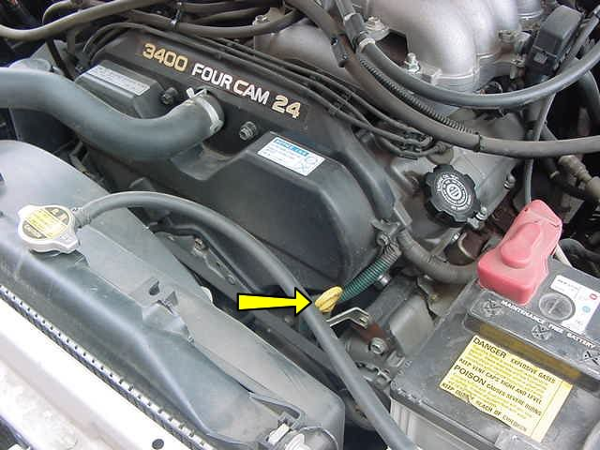
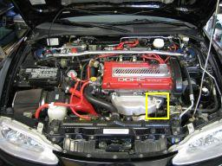
The Dipstick
Provides a method for checking the oil level

Slide 13
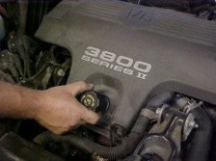
Oil fill cap
This is what you need to find and remove in order to add more oil

Slide 14
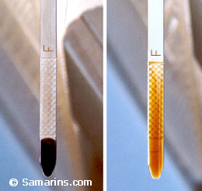
Checking oil
Park on level ground
Find the dipstick and pull it out
Wipe the oil off
Re-insert the dipstick all the way back in
Pull the stick out and read the gauge
The distance between full and low is one quart
You would be amazed at how many people are CLUELESS!

Slide 15
S.A.E.
The Society of Automotive Engineers
A membership society for mobility engineering.
They set standards and provide certification in the transportation industry

Slide 16
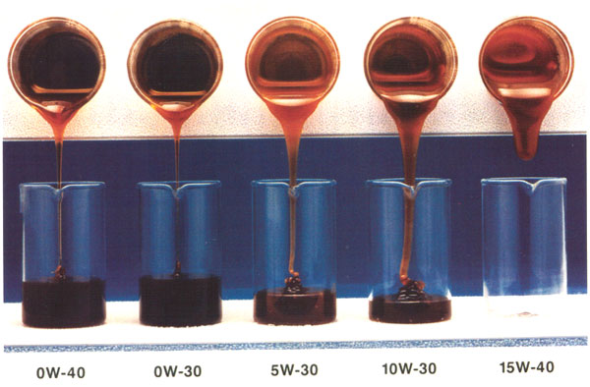
The SAE rates oil for Viscosity
Viscosity means Resistance to flow
Viscosity changes with heat
0
50
32F 20F 10F 0F -10F

Slide 17
The SAE rates oil for Viscosity
Viscosity means Resistance to flow
Viscosity changes with heat
For example a 30 viscosity oil will flow very slow at 0 and much faster at 200, but will always flow like a 30

Slide 18
The higher the number the slower the flow
A low number (5, 10) will flow quickly at low temps, but will not protect the parts well at high temps
A high number (30,40) will not flow when cold, but will still be thick enough to provide a good film on the parts when hot

Slide 19
The solution – multi-grade oils
5W-30 is the most recommended grade of oil by manufacturers.
It will flow like a 5 would flow when it is cold
It will flow like a 30 would flow when it is at operating temperatures
The W means winter

Slide 20
What do you want?
What the manufacturer recommends in the owner’s manual
Thinner oils give you easier starts, better protection on cold start up, better fuel mileage
Thicker oils protect at high temps, seal old engines and provide better pressure on worn out engines

Slide 21
API – American Petroleum Institute
Run by and for the petroleum industry
Provides standards for the engine oil manufacturers as an Oil Service Classification
Current standards are SM and CG

Slide 22
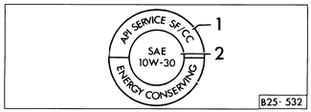
S and C
S= Spark= gasoline engine
C = Compression = Diesel engines
Some new diesels are calling for S engine oil

Slide 23
The second letter is the version number
SA and SB are no additive or light additive oils
SC was good from 1964 to 1967
Currently at SM
All previous engines can run later versions

Slide 24
The doughnut
If it does not have a doughnut, it has not been tested by the SAE and the API

Slide 25
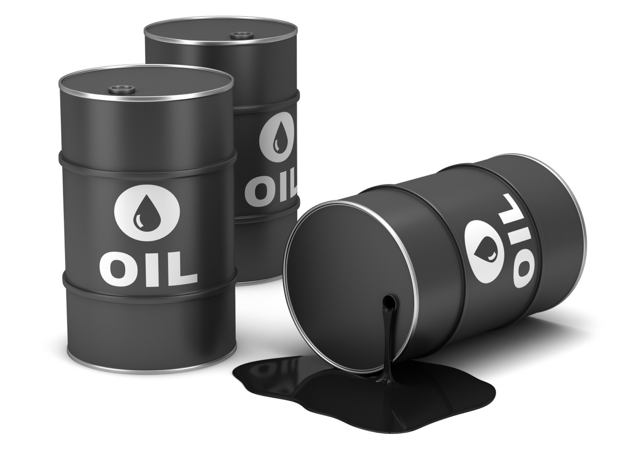
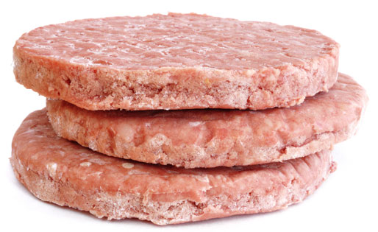
Additives
The oil contains additives to control
Multi-grade flow
Corrosion and acidity
Sludge (wax crystal) build up
Foaming
Particulate fallout
Oil molecule breakup under high pressure
Dry start up

Slide 26
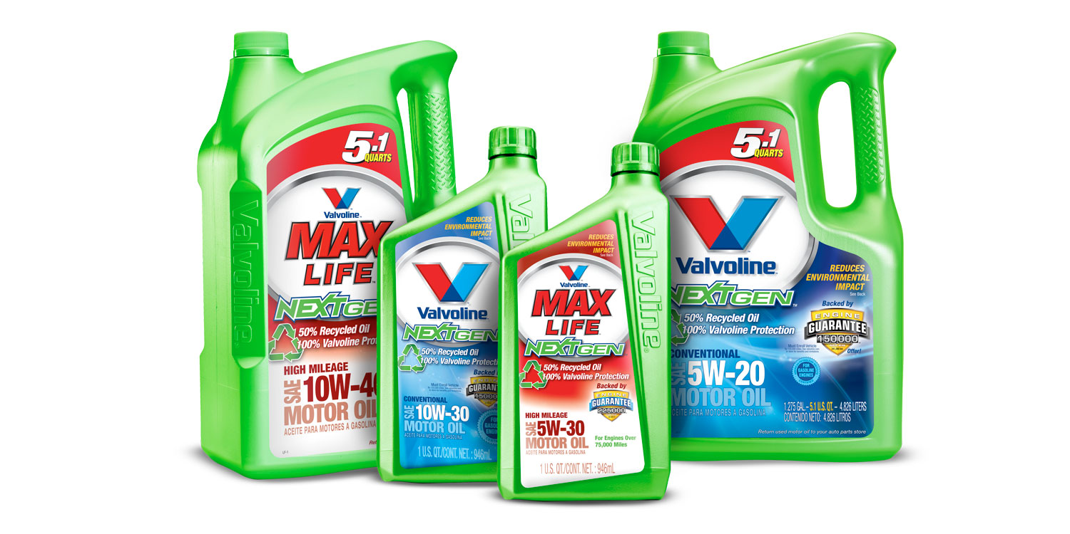
Those additives wear out
You really would never need to change your oil if it never got dirty or contaminated and if the additives never wore out. But they do….
Is there a SOLUTION?

Slide 27
WHAT IF I DON’T! change my oil?
Have you know anyone that hasn’t changed there oil for a long period of time that had something seriously bad happen to their engine?
If so lets split into groups and share.

Slide 28
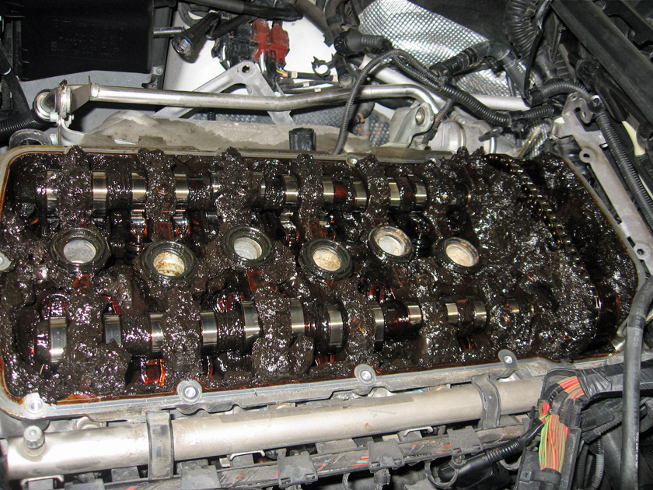
SLUDGE!
This WILL kill an engine

Slide 29
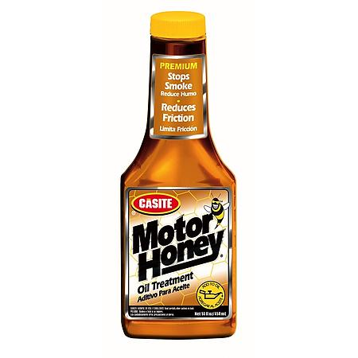
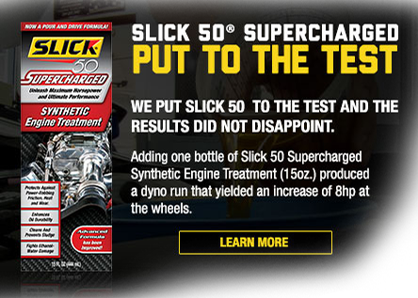
Snake oil additives
Prolong, Slick 50, Lucas oil treatment, Motor Honey, etc. are thickeners or additive packages.
They will often hurt your car, It helps rarely

Slide 30
Synthetics
There is much debate about synthetic oils
There is little doubt they are better
There is a lot of speculation about if they are worth the cost
Some cars come from the factory with synths
www.bobistheoilguy.com for more info
http://www.youtube.com/watch?v=TgtUDTFxOkQ

Slide 31
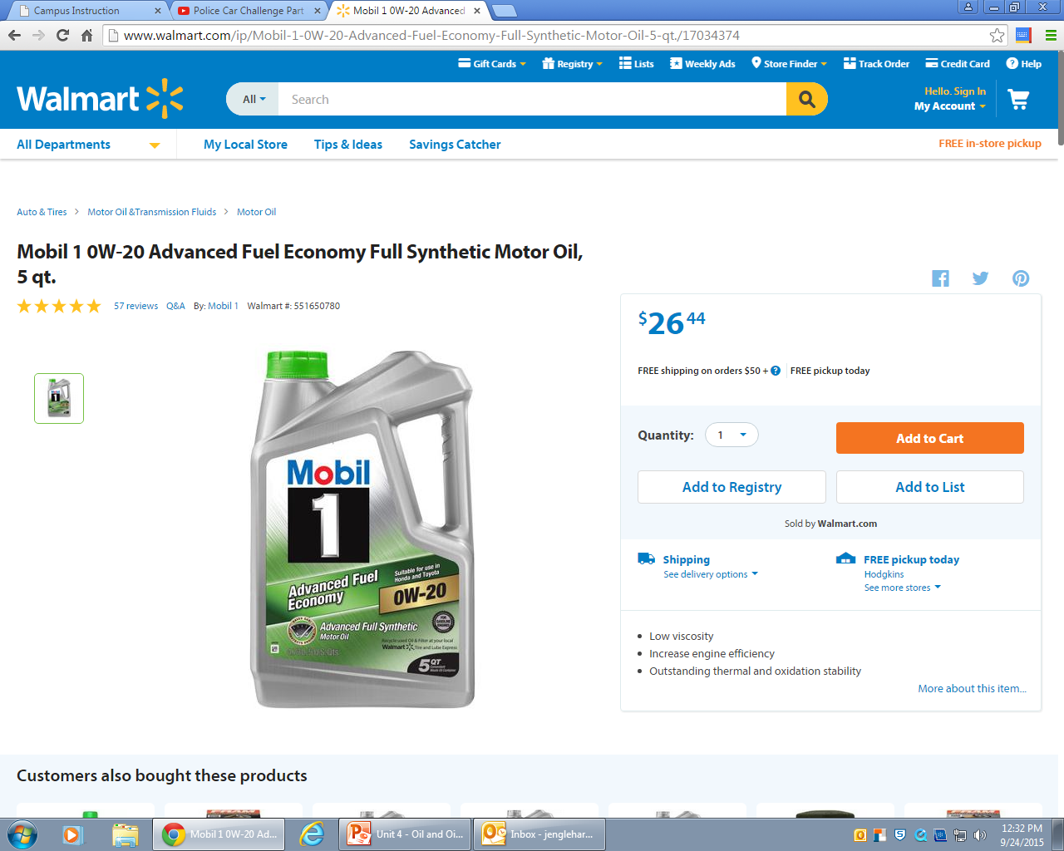
Synthetics
What is the cheapest place to buy synthetic oil from?

