Slide 1
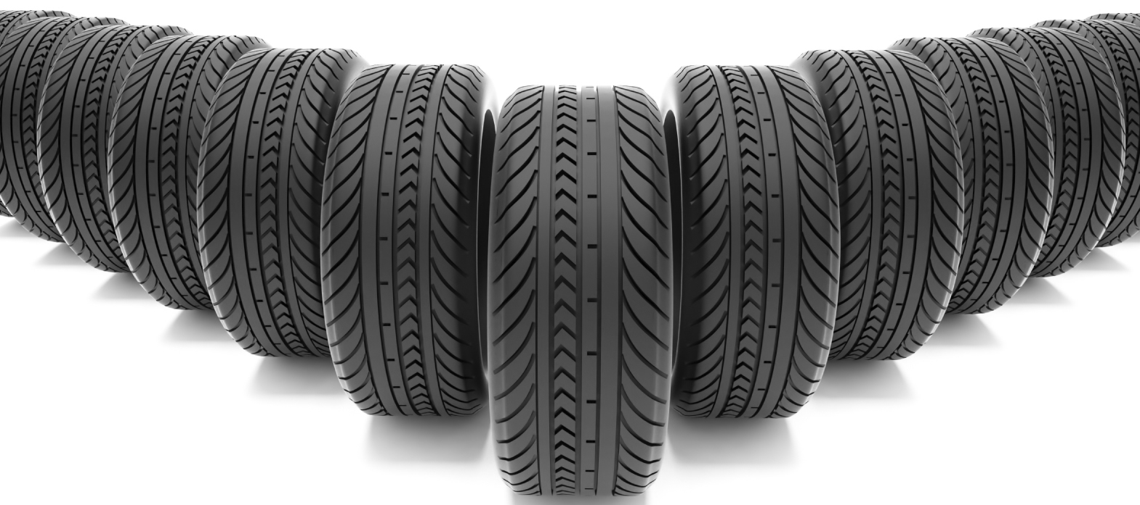
Tires
“Secrets to Success”
- Unit 6 -

Slide 2
In the bad old days…

Slide 3
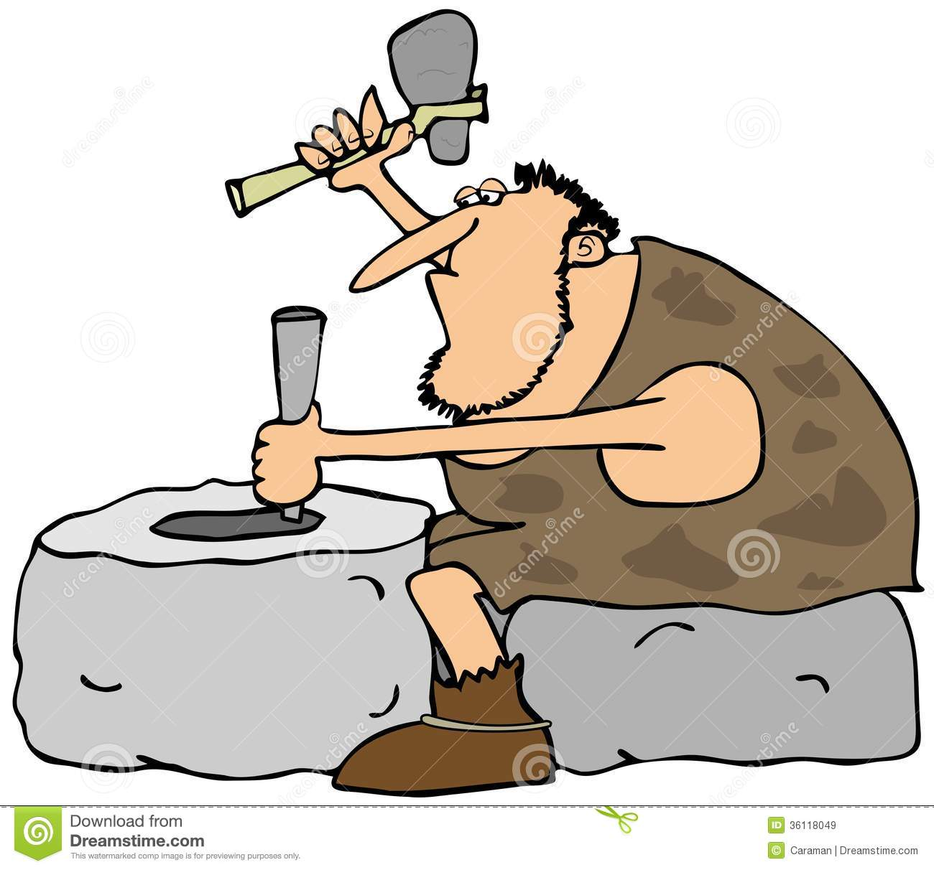
In the really bad really old days

Slide 4
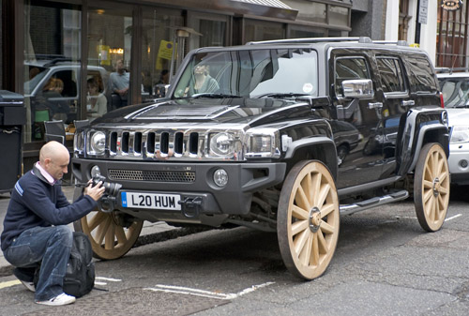
And the confused days…

Slide 5
Pneumatic Tires
Dunlop patented them for bicycles in 1888
Michelin put them on cars in 1895
Goodyear was started in 1898. Named after the inventor of vulcanized rubber.

Slide 6
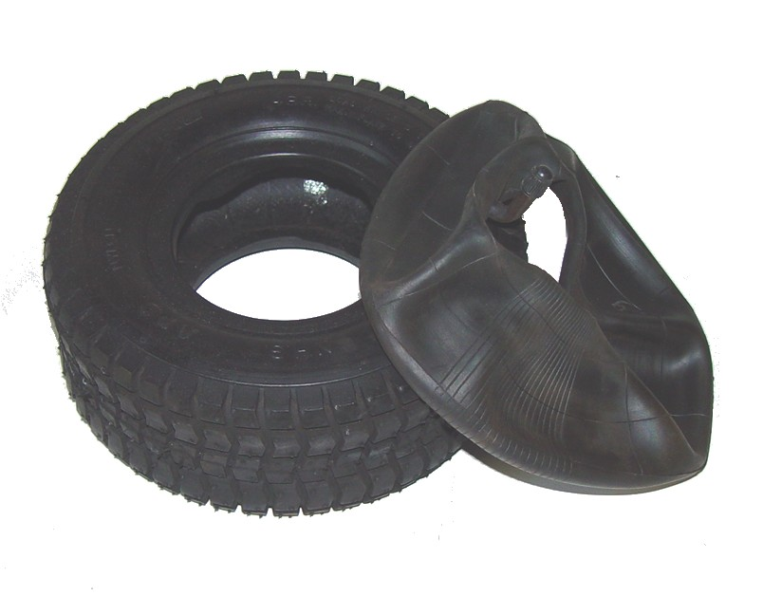
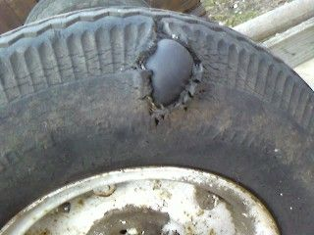
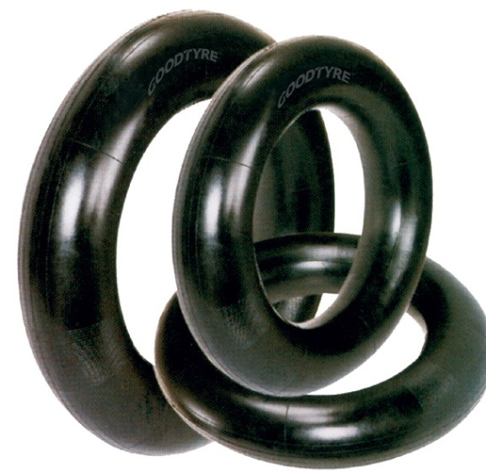
Inner tube tires
Tires with inner tubes were used until the 50s. Inner tubes have a few benefits.

Slide 7
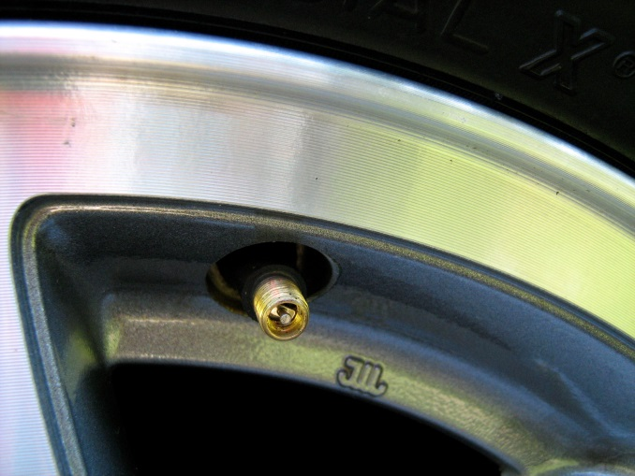
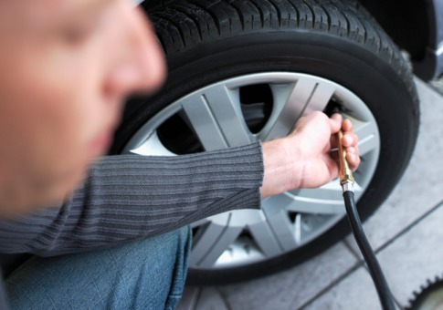
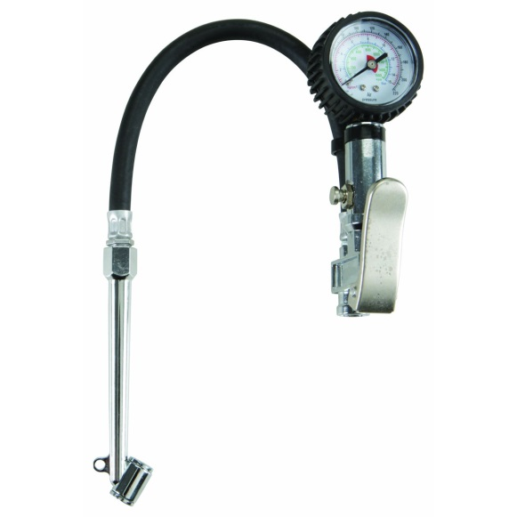
How to fill up a Tire?
Dunlop patented them for bicycles in 1888

Slide 8
What should your tire pressure be?
Max inflation on the side of the tire
Manufacturer suggested pressure on the door pillar tag.
Overinflation gets better fuel mileage
Underinflation gets slightly better ride and better off-road traction
Check when ambient temperature

Slide 9
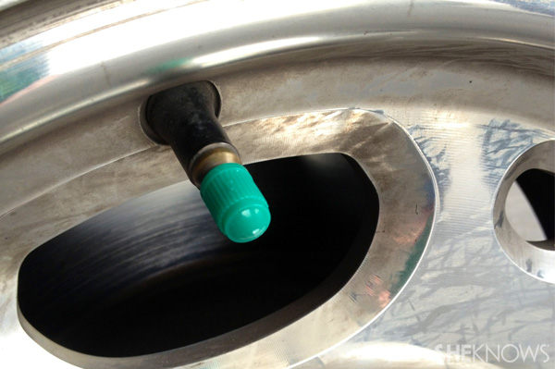
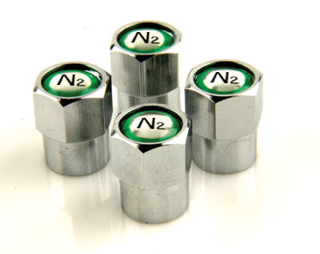
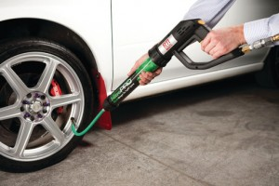
N2? What’s with the green caps?
Benefits?
Side effects?
Cost Effective?

Slide 10
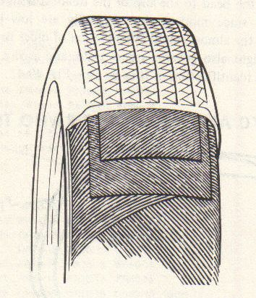
Bias-ply tires
Tire Designs
Had plies of cords that ran at 55 degree angles to the rim.
Pliable, but lots of rolling resistance.

Slide 11
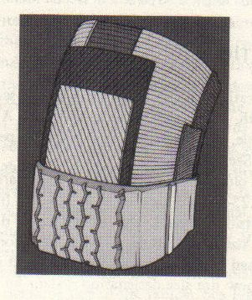
Radials
Tire Designs
Introduced in 1948 by Michelin
Americans resisted until the 70s
By 1982, all cars sold in the US had steel belted radials

Slide 12
Tire Construction

Slide 13
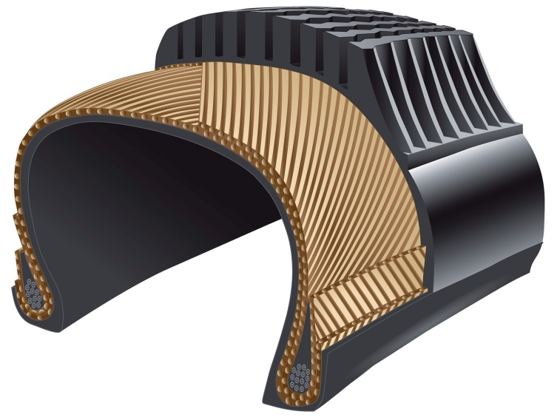
Sidewall construction
Sidewalls hold the tire up
More plies:
Carry more load,
less side to side
movement
Less plies: Softer ride

Slide 14
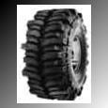
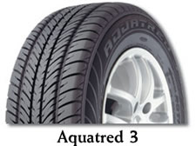
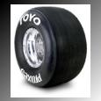
Tread design
Which tire has the best traction?
A B C

Slide 15
Tread characteristics
More rubber to the ground means more friction
Too much rubber on the ground leaves no room for water to escape
Small voids pack full of snow and mud
Large voids squirm and howl

Slide 16
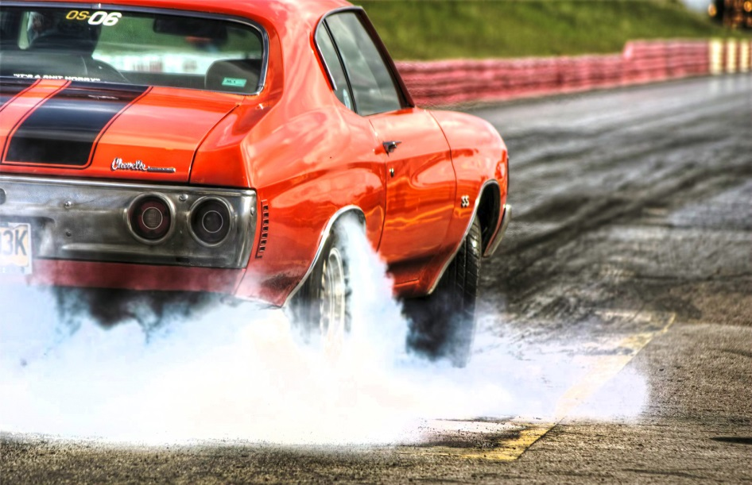
Tread composition
Soft tread
sticks better
Hard tread
lasts longer
Hot vs. Cold

Slide 17
UTQGS Tread codes Uniform Tire Quality Grading Standards
Traction – A B C
Straight ahead traction on a wet surface
Temperature – A B C
Represent a tire’s ability to withstand heat
Treadwear – between 60- 620
Tires are tested in controlled conditions on a government test track.
For comparison purposes. The numbers don’t mean anything

Slide 18
Tire Sizes
Old time codes
70D
Sizes in inches
35X12.5X15
P-metric codes
P185/75R15

Slide 19
Old time tire with code

Slide 20
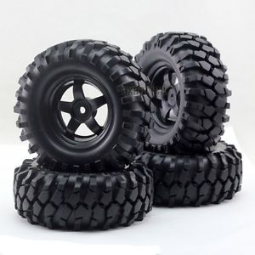
Inch size tire

Slide 22
Tire Classifications
Tread Design
M + S
Snow
Tire Sizes

Slide 23
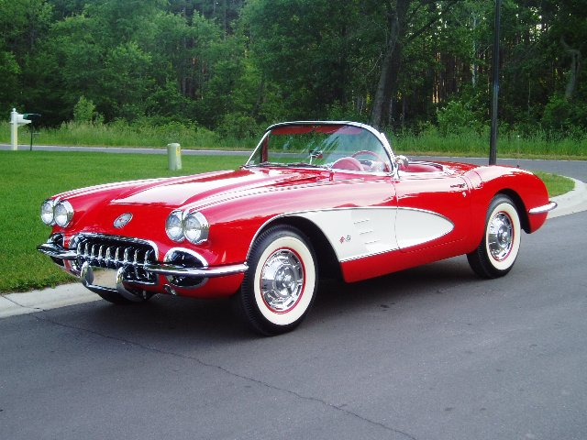
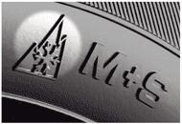
Snow tires in action?
RWL – Raised white lettering
OWL – Outline white lettering
White wall vs. black wall
M&S – Mud and Snow

Slide 24
Tire Classifications
Tire Plies
Tire Grading
Treadwear
Traction
Temperature

Slide 25
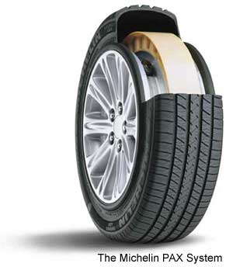
Tire Classifications
Run Flat Tires
Self-sealing
Self-supporting
Tire/wheel combination
systems

Slide 26
Tire Care and Maintenance
Tire Wear Indicator Bars
Set at 2/32nds of an inch (1.6 mm)

Slide 27
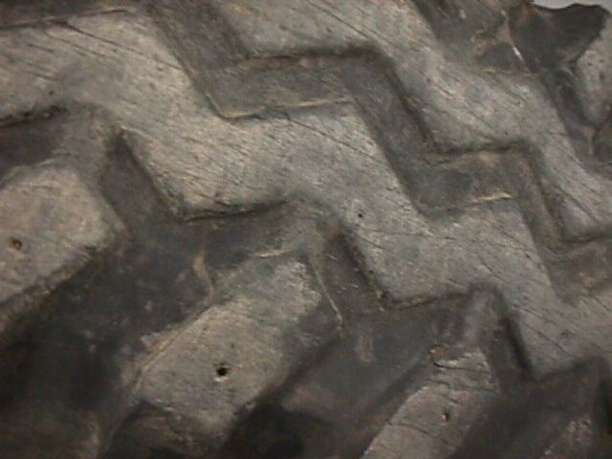
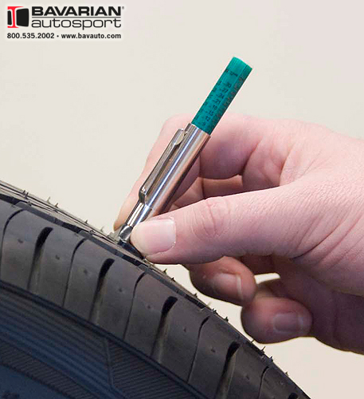
Wear bars
Tires can use bars or dots to indicate wear

Slide 28
Tire Care and Maintenance
Torque lug nuts in a star pattern

Slide 29
Tire Care and Maintenance
Tire Repairs
Use a patch/plug combination – requires removal of tire from wheel
Do not repair sidewalls
Tire Pressure Monitoring System
Monitors tire pressure
Required on vehicles built on or after Sept 1st, 2007

Slide 30
Tire Care and Maintenance
Always refer to the tire placard for tire pressure information

Slide 31
Review questions
Q. What does a Traction rating of “B” mean?
A. it is the middle grade for straight ahead wet traction
Q. What is a M&S tire good for?
A. Mud and Snow
Q. What does 305/80R16 mean?
305 mm wide/ 80% tall Radial 16” rim

Slide 32
More review questions
Q. What tread design helps in ice?
A. siping
Q. What is the measurement of a bald tire?
A. 2/32” or less
Q. What is hydroplaning?
A. Water trapped under the tire lifts the tire off the road.

Slide 33
Why do tires wear?
Cornering forces
Driving forces
Misalignment
Bad steering parts
Bad shocks
Scuffing
Skidding

Slide 34
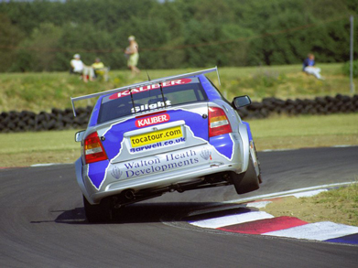
Cornering forces

Slide 35
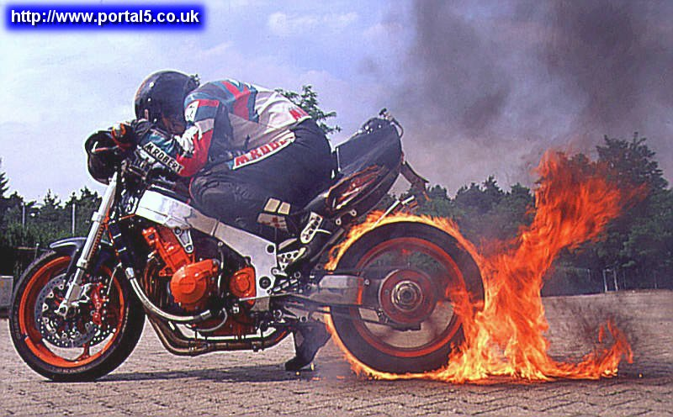
Driving forces

Slide 36
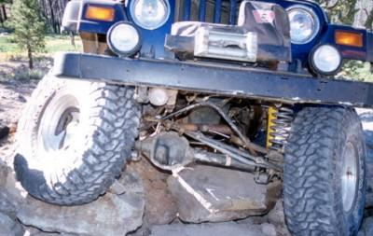
Misalignment

Slide 37
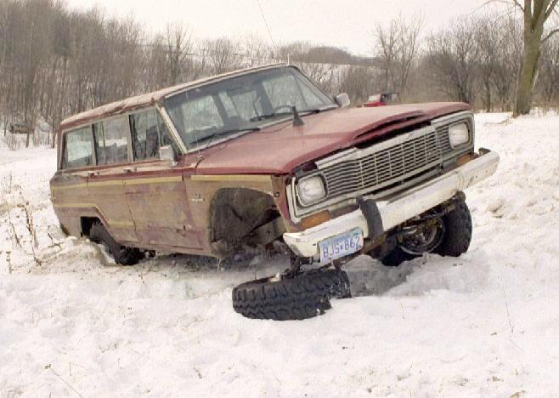
Bad steering parts

Slide 38
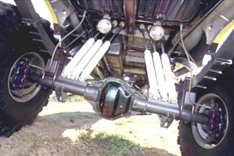
Bad shocks

Slide 39
scuffing

Slide 40
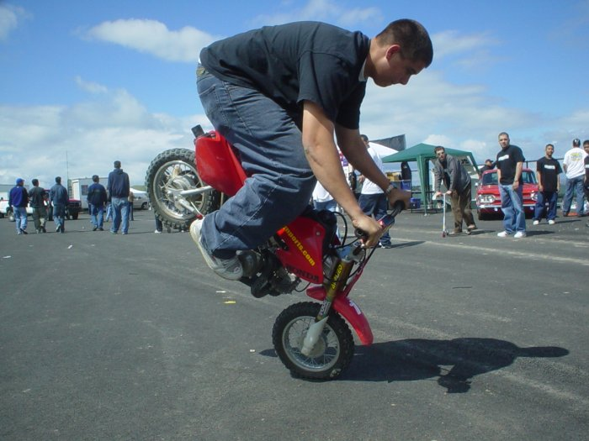
Skidding

Slide 41
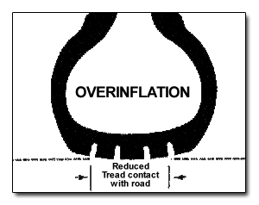
Overinflation

Slide 42
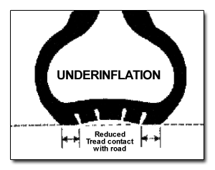
Underinflation

Slide 43
Tire Care and Maintenance
Tire wear

Slide 44
How can you make your tires last longer?

Slide 45
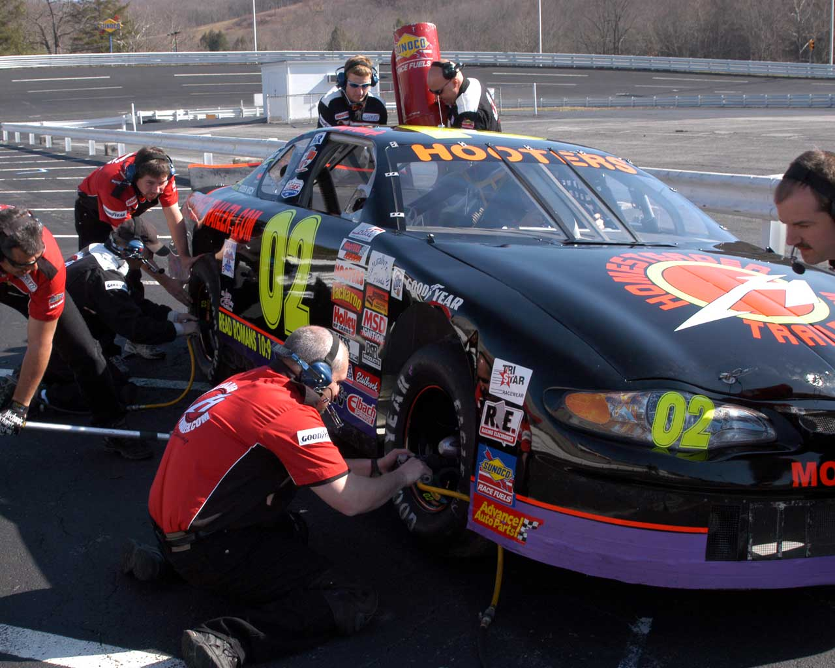
Rotate your tires

Slide 46
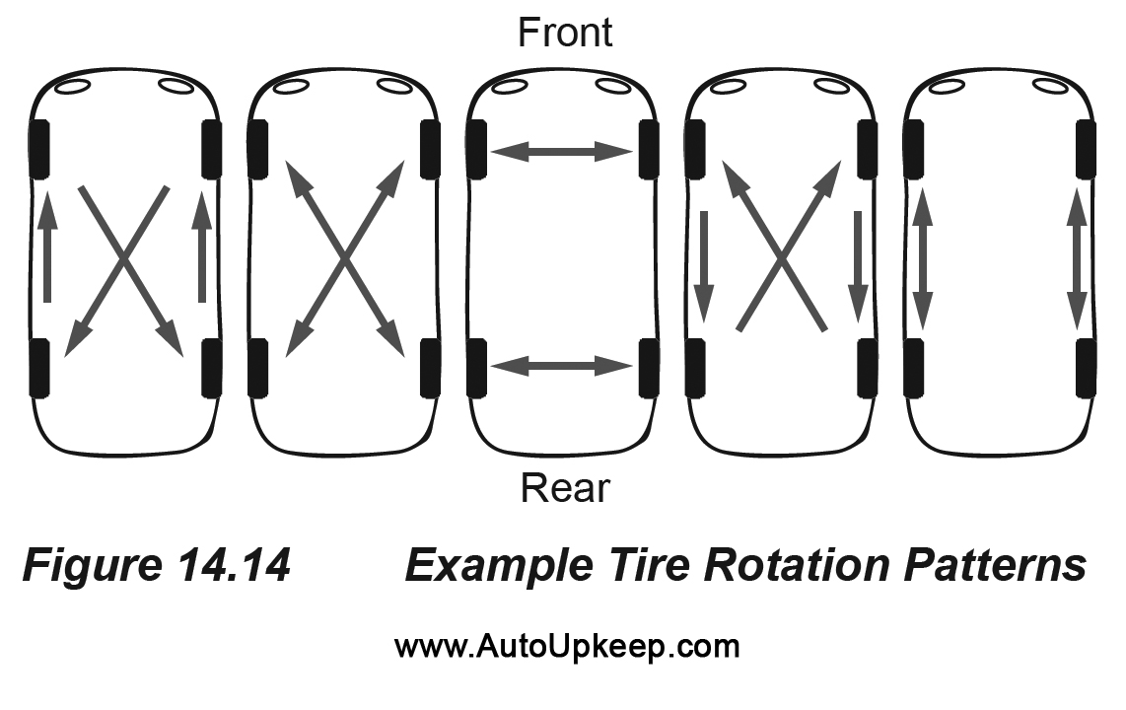
Tire Rotation patterns
The average tires should be rotated every 10K miles
RWD AWD / 4WD FWD Directional

Slide 47
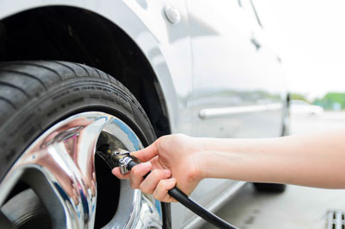
Do not over inflate your tire! Check with your owners manual or B-pillar

Slide 48
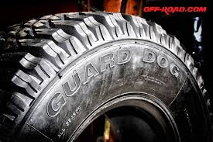
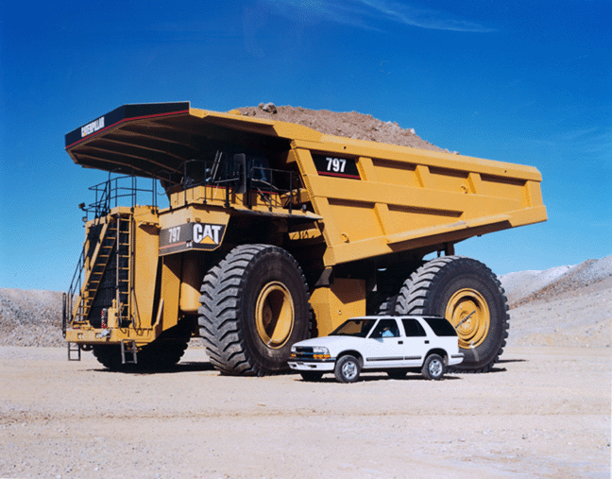
Lets see how it’s made!
Tires: How its made

Slide 49
The future of tires?
Secrets to success

Slide 50
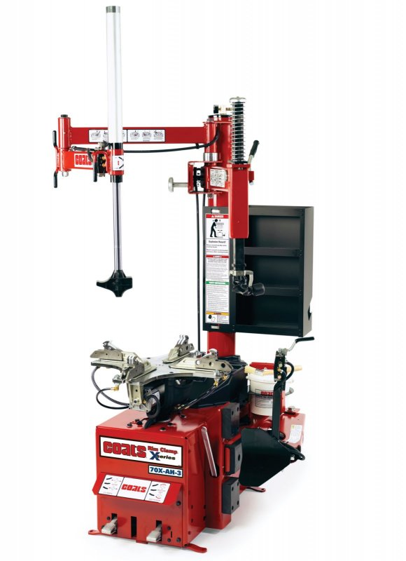
Tire Machine
Secrets to Success

